Slide 1
ANA- To Do or Not To Do
Ryan L. Ragle M.D.
03/23/2025
OPA Rheumatology and Infusion

Slide 2
ANA

Slide 3
Disclosures and Conflicts of Interest
No disclosures or conflicts

Slide 4
ANA
First described in the late 1940’s
LE cells seen in bone marrow of SLE patient
Leucocyte containing phogocytosed nuclear material of other cells
DsDNA-1957
ENA antibodies-1966
Now over 150 identified

Slide 5
Irure-Ventura J. et al.

Slide 6
ANA
ANA is NOT a screening test
High Sensitivity with low specificity
High false positive rates
Includes two broad types of antibodies targeting proteins in nucleus of cells
DNA and Histones
Extractable nuclear antigens (ENA:SSA, SSB, Smith (Sm), RNP, SCL-70 etc.)
Cytoplasmic proteins may also be targeted
Types of ANA testing
ANA IFA, ELISA, multiplex
Proprietary names: ANAchoice, ANA direct, AtheNA multi-lyte
Default testing through most labs for “ANA” is most often not IFA

Slide 7
ANA IFA
Indirect immunofluorescence assay (IFA) -Recommended
Tests for ≈150 different ANA antibodies
Technician dependent, reagent dependent and labor intensive
Newer automated systems are available
Fixed cells on slide patient serum ANA’s bind to antigen wash
fluorescein-labeled anti-human IgG wash Fluorescent scope
HEp-2 cells derived from human laryngeal carcinoma (since 1980) but historically mouse kidney and rat liver used (1950-1980)
Most labs use ≥ 1:40 or 1:80 for normal cutoff
Newest EULAR/ACR SLE criteria requires at least 1:80
Values >1:1280 is generally not further quantified at most labs
Titer does not predictably correlate with clinical disease activity

Slide 8
ANA IFA

Slide 9
ANA IFA
Nuclear patterns
Homogenous, speckled, peripheral/rim, nucleolar, centromere, nuclear dots
Cytoplasmic patterns
Speckled, mitochondrial
Mitotic patterns
Mitotic spindle, centrosomes
Positive IFA is not equivalent to diagnosis of ANA related connective tissue disease and follow up testing/clinical evaluation is necessary
ds-DNA and ENA antibodies
Consider testing for other common causes of positive ANA if clinically appropriate

Slide 10
ANA: ELISA
ELISA
Easier to automate, quicker
Antibody coated well or wells serum added ANA’s bind to antigen
wash labeled ligand added comparison to standard concentration of ANA
May use synthetic vs extracted antigens (from HEp-2 cells) or a combination of both
Sensitivity and specificity dependent on specific lab methods and reagents
Sensitivity varies between 69-98% depending on lab (using gold standard of IFA positive to at least 1:160 titer)
Can detect “low affinity” antibodies which have questionable clinical significance
ss-DNA can result in overestimate of ds-DNA
Some ELISA tests are not as reliable for nucleolar ANA’s
Reported in units (u) or International units (iu)
In general 1:40-1:80 correlates to 5-10 iu
Normal ranges may vary by lab

Slide 11
ANA: Multiplex Immunoassay
Multiplex immunoassays- simultaneous testing of multiple specific ab (ds-DNA, SSA, SSB, SCL-70, chromatin, smith, RNP, sm/RNP, Jo-1, ribosomal P, centromere B etc.)
ANAdirect/ANA qualitative by multiplex- Labcorp
ANAchoice/ANA Multiplex-Quest
Semi-quantitative
Rapid and high throughput (results in as little as 90 min)
No standardization between labs

Slide 12
ANA- multiplex microbead assay
https://www.aacc.org/publications/cln/articles/2014/june/ana-testing

Slide 13
ANA- Multiplex assays

Slide 14
ANA: ds-DNA and ENA antibodies
Reflex testing for specific ds-DNA and ENA antibodies may be done by multiple methods
ELISA
Multiplex assays
Radial immunodiffusion
IFA testing for ds-DNA is considered gold standard
Most common reflex antibodies
ds-DNA, SSA, SSB, smith, RNP, smRNP, SCL-70, centromere B, Jo-1, Ribosomal P, chromatin
Common to have more than one specific antibody
Antibodies may be associated with more than one specific disease process

Slide 15
ANA
Labs may do tiered/cascading reflex testing that will test groups of antibodies until positive test obtained
May miss clinically significant antibodies if ordering provider unaware of testing methods
Example: ANAchoice-positive (Multiplex assay of 11 antibodies) reflexes to:
Tier 1: ds-DNA, sm/RNP, sm, RNP, chromatin
Tier 2: SSA, SSB, scl-70, Jo-1
Tier 3: centromere B, ribosomal P
All tests must be interpreted with specific test and clinical scenario in mind

Slide 16
ANA
http://www.questdiagnostics.com/testcenter/testguide.action?dc=TG_Autoimmune_AbTesting

Slide 17
ANA
Disease | % with positive ANA
SLE | 98-100
Systemic Sclerosis (scleroderma) | 95
RA | 45
Sjogren’s | 75-90
Mixed connective tissue disease | 100
Raynaud’s | 40
Drug induced Lupus | 80-95
Polymyositis/dermatomyositis | 35
Juvenile idiopathic arthritis | 15-40
Hashimotos thyroiditis/Graves | 50
Autoimmune hepatitis | 70
Primary biliary cirrhosis | 50-70

Slide 18
ANA
Disease | % with positive ANA
Multiple sclerosis | 25
Women with silicone breast implants | 25
Healthy relative of SLE | 15-25
Cancer | 15-25
Elderly (>70) | 30+
Healthy children | 2

Slide 19
ANA-Still other causes
Infectious diseases
EBV
HIV
Hepatitis C
Parvovirus B19
Bacterial endocarditis
Syphilis
Other automimmune/inflammatory disease
Idiopathic pulmonary arterial hypertension: 40%
Inflammatory bowel disease

Slide 20
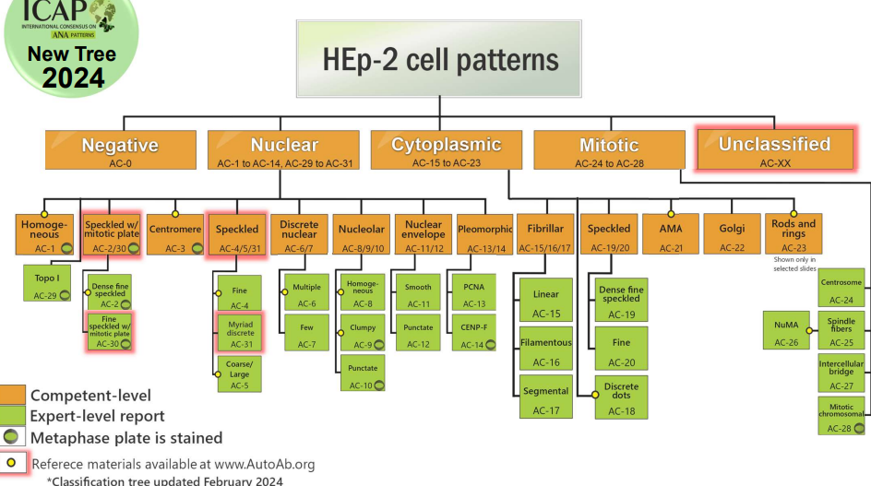

Slide 21
ANA IFA Patterns

Slide 22
ANA IFA Patterns

Slide 23
ANA IFA Patterns
Notes:
Patterns correlate with different diseases.

Slide 24
ANA IFA Patterns
Less common patterns
Few nuclear dot-Primary biliary cirrhosis
Dense fine speckled (DFS-70 antibody)-not typically associated with auto-immune disease
Reticular/AMA (antimitochondrial antibody)-primary biliary cirrhosis or rarely in systemic sclerosis

Slide 25
ANA Specific Autoantibodies
Antibodies Disease associations
Anti-dsDNA SLE, Nephritis
Anti-Smith SLE, ILD
Anti-RNP SLE, MCTD
Anti-ribosomal P SLE, CNS lupus
Anti-chromatin Drug induced SLE, SLE, MCTD
Anti-histone Drug induced SLE, SLE
SS-A/Ro Sjogren’s, Congenital heart block, neonatal lupus, SCLE
SS-B/La Sjogren’s, RA
Anti-Scl-70 Diffuse systemic sclerosis (scleroderma)
Anti- Jo-1 Myositis, ILD
Centromere B Limited systemic sclerosis(CREST)
Notes:
Antigen specificities of autoantibodies
Primer on the Rheumatic Diseases. 9th ed, copyright 1988. Used by permission of the Arthritis Foundation.
#9203120

Slide 28
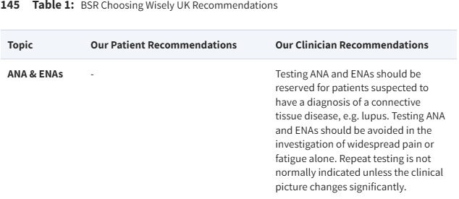

Slide 29
ANA: Pitfalls and complications
Positive in 10% of normal individuals
Positive in 20% of patients with first degree relative with autoimmune disease
Positive in 25+% of elderly
ANA is positive in other diseases
Rheumatologic
Non-Rheumatologic
ANA testing is sensitive, it is not specific
low disease prevalence further lowers positive predictive value
ANA titer does not correlate with disease activity
Why do we care
Anxiety induced in patients/family with positive test
May result in harm: 39/137 patients in a series with positive ANA but no evidence of rheumatic disease were treated with prednisone (doses as high as 60mg/day)
Cost

Slide 30
ANA: Pitfalls and complications
Health care costs associated with testing
Repeat testing is not indicated unless there is strong clinical suspicion of an evolving disease process or change in symptoms that suggest new connective tissue disease
ds-DNA and ENA antibodies should not be checked routinely unless ANA is positive
Bristish coloumbia 2011/12
94000 ANA tests ($2.24 million)
Estimated incidence of new cases of ANA related disease in same population<400
Guidelines recommended by BC Health Care System Panel
ANA testing need only be ordered once.
ANA testing is NOT indicated unless a connective tissue disease (e.g., systemic lupus erythematosus (SLE), scleroderma, Sjogren's syndrome, polymyositis/dermatomyositis) is a significant clinical possibility.
ANA testing is NOT indicated as a screening test to evaluate fatigue, back pain, or other musculoskeletal pain without other clinical indications.
ANA testing is NOT indicated to confirm a diagnosis of rheumatoid arthritis (RA) or osteoarthritis (OA).
New Jersey 330 bed community hospital over 1 year
465 patients had ANA ordered at a cost of $39k
Additional testing directly associated with ANA $87k
Chart review suggest 93% of these tests were ordered in patients with negative ANA IFA
No new diagnoses of SLE, 1 diagnosis of Anti-phospholipid antibody syndrome

Slide 31
ANA: Pitfalls and complications
Positive ANA and ANA specific antibodies associated with IVIG treatment
108 pediatric patients with IVIG exposure within28 days
1201 pediatric patients with no history of IVIG exposure
All patients in the IVIG group were positive for ANA or ANA specific antibodies
Most common: ANA, SSA, Ro-52, AMA
Xu Li., et.al.

Slide 32
ANA and IVIG

Slide 33
ANA in the unscreened patient

Slide 34
ANA IFA vs ELISA
149 consecutive patients with ANA orders tested both by ELISA and IFA.
Final diagnosis by rheumatologist
Overall
IFA-more sensitive but less specific
High negative predictive value
ELISA- Less sensitive but more specific
High positive predictive value
Khalifah MJ, et.al.

Slide 35
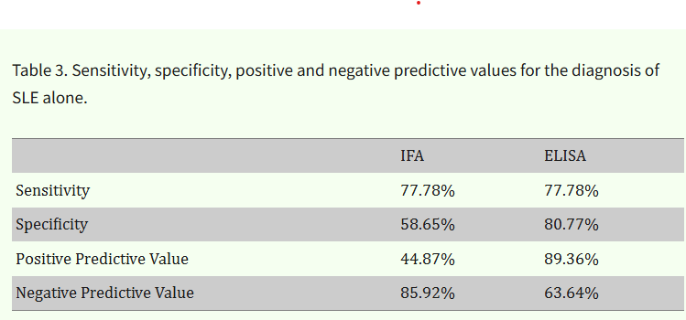
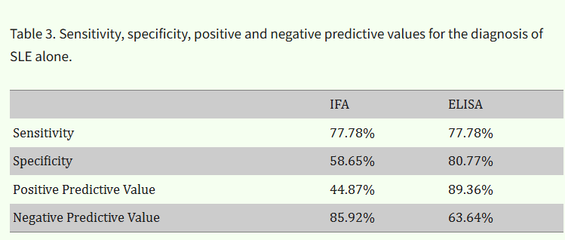
ANA IFA vs ELISA

Slide 36
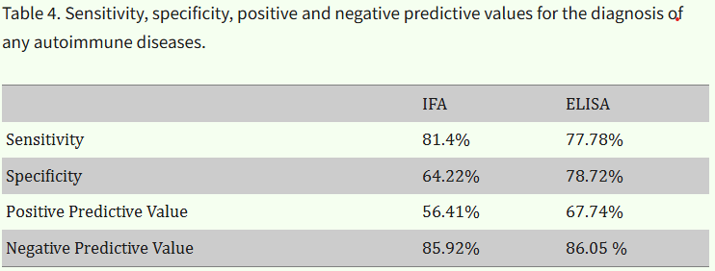
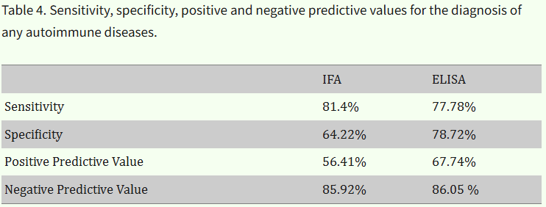
ANA IFA vs ELISA

Slide 37
ANA IFA vs ELISA

Slide 38
ANA in referred patients

Slide 39
ANA
University of Connecticut
Retrospective study of 232 sequential patients referred to Rheumatology Department for + ANA.
Abeles, Aryeh M. et al.

Slide 40
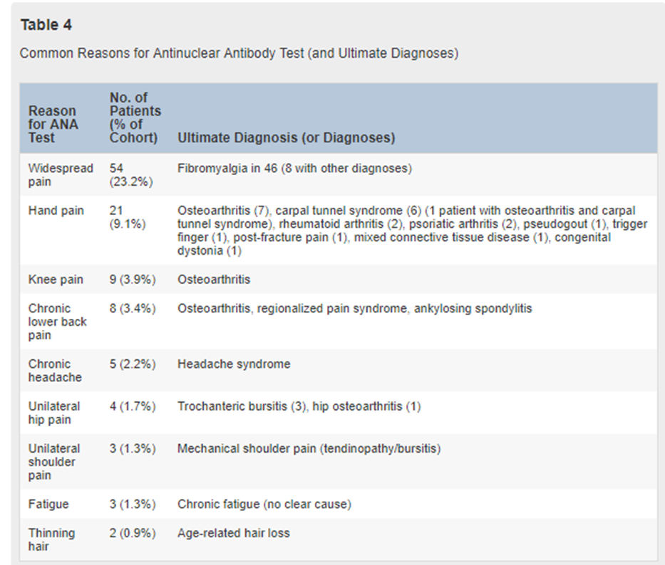

Slide 41
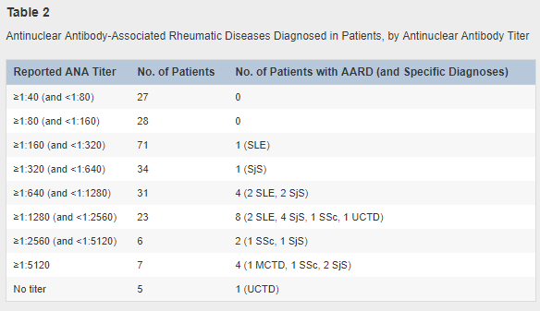

Slide 42
ANA
Results of rheumatologic evaluation
Any titer ANA: PPV of 2.1% for lupus, PPV of 9.1% for ANA associated rheumatic disease (SLE, MCTD, UCTD, Sjogren’s, Systemic sclerosis, inflammatory myopathy)
ANA ≥ 1:640: PPV of 6% for lupus, PPV of 26.9% for ANA associated rheumatic disease
No rheumatic disease in patient with <1:160 titer
No rheumatic disease in patients with ANA ordered for “widespread pain”
No significant difference in patients with disease when controlled for age, sex, referral by primary care vs specialist or site of ANA testing (outside lab vs university lab)
9.9% of patient had other rheumatic disease (RA 8, PMR 6, gout 3, spondyloarthritis 4, pseudogout 1, ANCA associated vasculitis 1)
30.8% of 91 patients tested for anti-thyroid antibodies were positive.

Slide 43
ANA
Who should be screened with ANA
Patients with high pre-test probability of ANA related connective tissue disease
Patients with 1 or more characteristic or specific manifestation of ANA related connective tissue disease

Slide 44
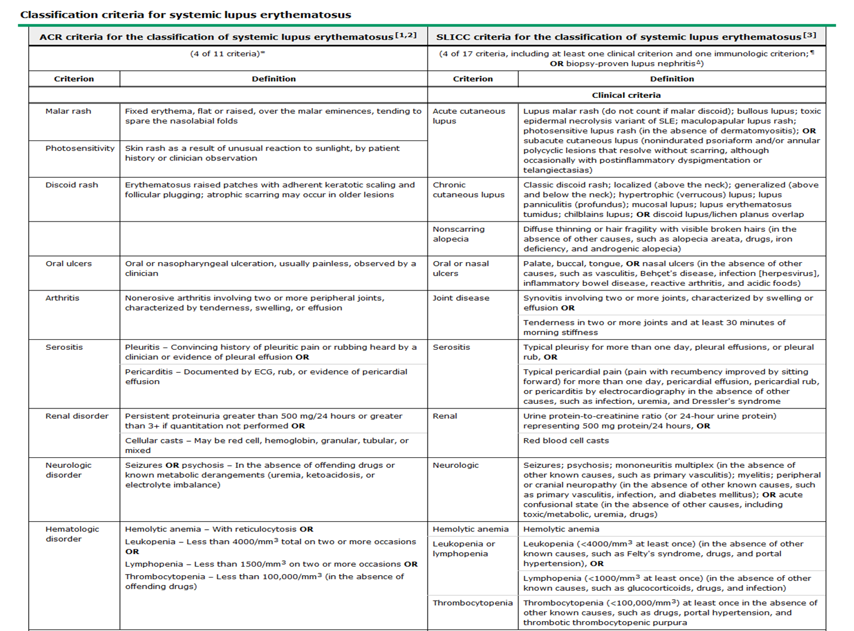

Slide 46
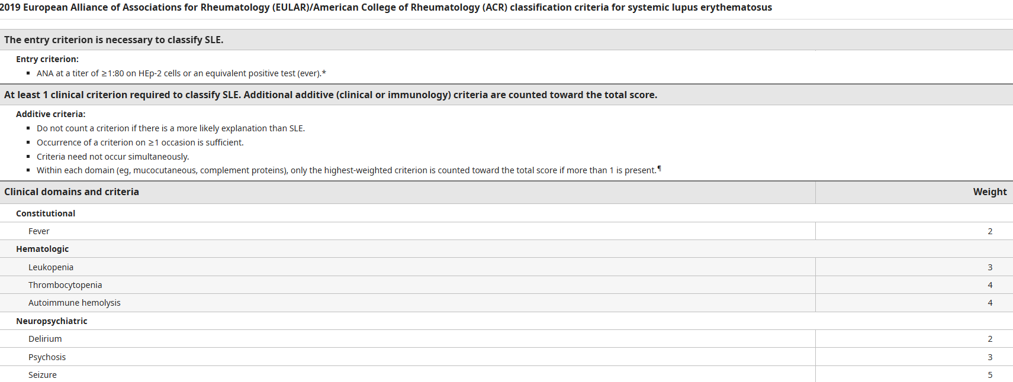

Slide 47
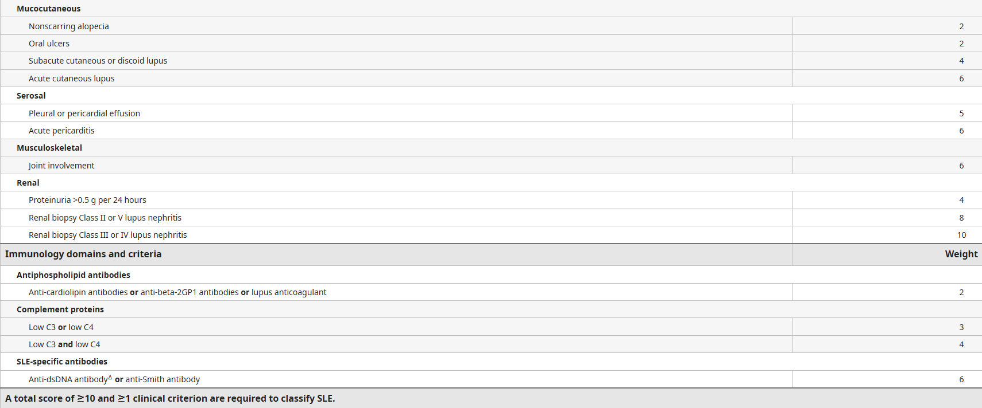

Slide 48
ANA Classification Criteria

Slide 49
ANA
Additional screening tests if appropriate to rule out other causes of ANA
Autoimmune hepatitis: smooth muscle/F-Actin, p-ANCA, antimitochondrial, Liver kidney microsomal-1 (LKM-1), Soluble liver antigen/liver pancreas (SLA/LP), serum IgG levels
Autoimmune thyroid: thyroglobulin ab, thyroid peroxidase ab, thyroid stimulating hormone receptor ab (higher association with Graves)
Myositis: CK, aldolase, LDH, myositis antibody panel

Slide 50
Quest

Slide 51
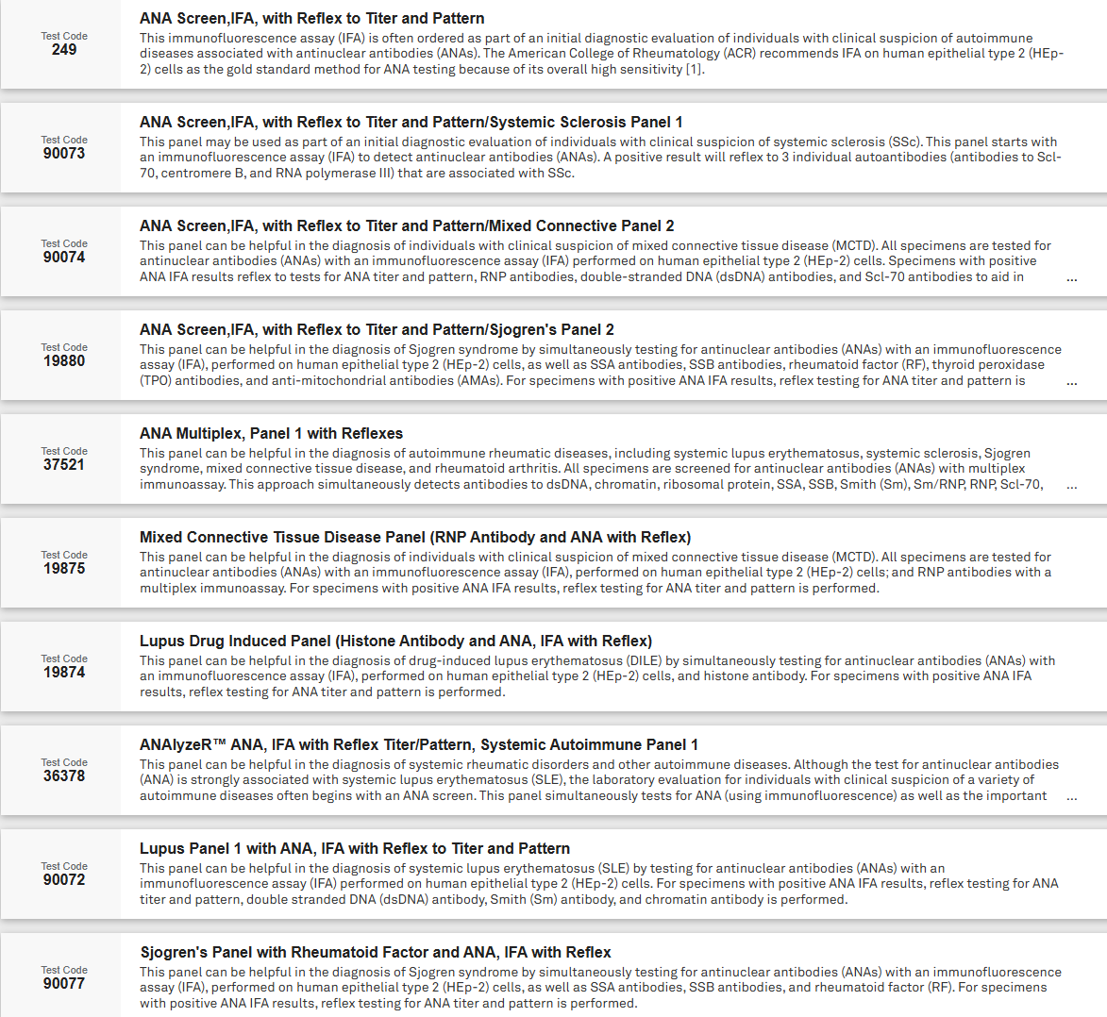

Slide 52
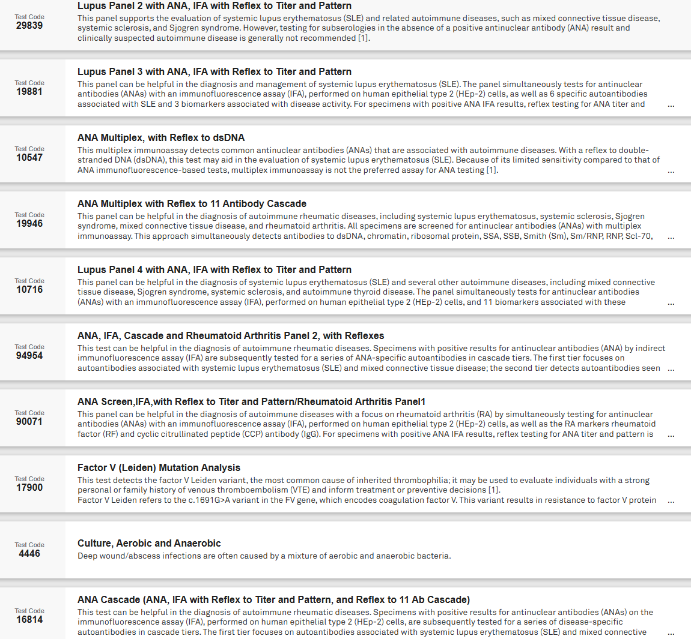

Slide 53
Quest
Recommended Quest test
Request lab to complete full cascade
-Tier 1: dsDNA, RNP, Smith/RNP, Smith, Chromatin
-Tier 2: SSA, SSB, SCL-70, Jo-1
-Tier 3: Ribosomal P, centromere B

Slide 54
Quest-ANAlyzeR™

Slide 55
Labcorp

Slide 56
Labcorp

Slide 57
Labcorp

Slide 58
Mayo- Central peninsula
-ANA by ELISA and CCP antibody
- if >3.0 then reflex to dsDNA, centromere, “ENA eval” and centromere ab.
-ENA eval: SSA, SSB, Smith, RNP, SCL-70 and Jo-1

Slide 59
ANA
What do I order
Custom panel through Quest
ANA by IFA with reflex to titer and pattern
Ds-DNA, SSA, SSB, smith, RNP, SCL-70, chromatin, centromere B
At least CBC, CMP, ESR,CRP and UA to assess for systemic and endorgan inflammation
Complement C3, C4 and CH50 activity
Low complements and low activity suggestive of active disease
Will often repeat any partial testing to obtain at least antibodies above and will order additional specific antibodies if clinically indicated
Myositis- Myositis antibody panel
Jo-1 Ab, PL-7 Ab, PL-12 Ab, EJ Ab, OJ Ab, SRP Ab, Mi-2 Alpha Ab, Mi-2 beta Ab, Mi-2 Beta Ab, MDA-5 Ab, TIF-1y Ab, NXP-2 Ab. Ku
Systemic sclerosis (if SCL-70 and centromere B are negative) and high suspicion
PM/SCL 100 and 75 (polymyositis overlap), RNA polymerase III (increased risk of renal crisis), U1-snRNP (Pulm htn, arthritis), U3RNP anti-fibrillarin (diffuse SSc, renal cardiac, ILD and pulm HTN), Anti-Th/To (localized cutaneous, pericarditis, ILD)

Slide 60
ANA-Cost and Coverage
Cost
ANA:$11-$500
Reflex testing
ENA panel:$100-$300
Complements-$50 each
ANAlyzeR™: $1300+

Slide 61
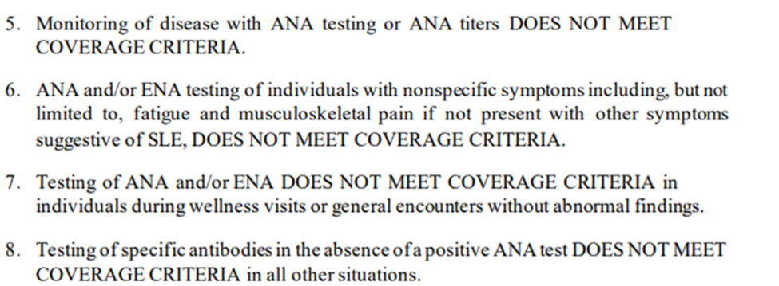
ANA-Cost and Coverage
Coverage-I have never heard of a denial in AK
Avalon Health Care Solutions
Lab Benefit management (think PBM for labs)
Multiple health plans in the Lower 48.

Slide 62
Systemic Sclerosis antibodies
https://testdirectory.questdiagnostics.com/test/test-guides/CF-SystemicSclerosis/

Slide 63
MCTD

Slide 64
MCTD
-Clinical manifestation of 85 MCTD patients from tertiary care center cohort

Slide 65
MCTD
Low positive RNP results (< or =4.0 U) without an associated positive antinuclear antibodies by indirect immunofluorescence assay should be interpreted with caution and is not likely to be related to MCTD or other connective tissue disease.
MCTD unlikely in the absence of raynauds.

Slide 66
Myositis
testdirectory.questdiagnostics.com/test/test-guides/CF_Myositis/

Slide 67
Myositis

Slide 68
Myositis

Slide 69
Initial Rheumatologic Evaluation
Inflammatory monoarthritis - arthrocentesis if possible, imaging of involved joint (septic, crystal arthropathy)
Inflammatory oligoarthritis - consider sending rheumatoid factor, CCP, ESR/CRP, ASO, films of involved joints, consider pelvis film (for sacroiliitis), consider arthrocentesis to prove inflammation.
Inflammatory polyarthritis - consider rheumatoid factor, CCP, ESR, ASO, hand/foot films, parvovirus titers (if acute), ANA if appropriate.
Inflammatory back pain- HLA-B27 and axial imaging
Bilateral ankles-sarcoid evaluation. (Ca, ACE, vitamin D, chest x-ray)
Shoulder and hip girdle stiffness, pain-If over 50 and increased ESR/CRP consider PMR
Non-infectious sinusitis/otitis, nephritis, pulmonary disease-ANCA (MPO and PR3)
Multiple (or single highly specific) symptoms of connective tissue disease-ANA by IFA with reflex

Slide 70
Anti-phospholipid antibody syndrome
Who should be tested
One or more unprovoked venous or arterial thrombus
One or more fetal death after 10 wks, premature birth 2/2 severe pre eclampsia or multiple pregnancy losses prior to 10wks
What should be tested
Lupus anticoagulant panel
Prolonged initial testing that fails to correct with mixing studies
Not accurate on anticoagulation though experienced labs may be able to neutralize effects of heparin (should be discussed with specific lab running test)
Anticardiolipin IgG, IgM, IgA >40
May be tested on anticoagulation
Beta 2 glycoprotein IgG, IgM, IgA >40
May be tested on anticoagulation
Positive test must be confirmed after 12 wks or longer
Recommend not testing “non-criteria antibodies” unless initial screening negative and high clinical suspicion persists

Slide 71
ANCA
C-ANCA (PR3)-cytoplasmic staining on IFA
Granulomatosis with polyangiitis (Wegener’s)
P-ANCA (MPO)-perinuclear staining on IFA
Microscopic polyangiitis, Eosinophilic Granulomatosis with polyangiitis (Churg-Strauss)
inflammatory bowel disease
Recommend ANCA screen by IFA with reflex to MPO and PR3 abs

Slide 72
HLA - B27
Human Leukocyte Antigen.
MHC class I - participates in antigen presentation
Genetic marker with disease association.
Present in 5-15% of general population.
<5% of patients with HLA-B27 will develop a spondyloarthropathy.

Slide 73
HLA-B27
 | Frequency of HLA-B27 (%)
General Population | 7%
Ankylosing Spondylitis | 95%
Reactive Arthritis | 70%
Psoriatic Arthritis | 25%
Psoriatic Spondylitis | 60%
Enteropathic Arthritis Enteropathic Spondylitis | 7% 70%

Slide 74
Rheumatoid factor
Autoantibodies to the Fc portion of IgG.
IgM RF is most common clinically tested
Tested by ELISA or agglutination
Normal range <15
IgA and IgG have limited clinical utility
Most labs offer subtype testing
Wide ranges of sensitivity and specificity depending on population and control groups used
Positive RF associated with more severe disease and increase in extra-articular manifestations
No utility to repeating RF unless early in disease and looking for seroconversion to help guide clinical management
No clear correlation between change over time and disease activity

Slide 75
Rheumatoid factor
Disease | % positive RF
Rheumatoid arthritis | 80
SLE | 15-35
Sjogrens | 75-95
MCTD | 50
Cryoglobulinemia | 90
Poly/dermatomyositis | 5-10
Scleroderma | 20
Juvenile idiopathic arthritis | 10

Slide 76
Rheumatoid Factor in Nonrheumatic Disease
Normal individuals < 5%
Elderly up to 30%
Infections
Endocarditis 25-50%
Minor criteria in Duke’s criteria for endocarditis
leprosy
Syphilis 13%
Lyme disease
Periodontal disease
Parasitic diseases 20-90%
Viral infections 15-65%
Hepatitis C (also A & B) 20-75%
Parvovirus
Rubella
CMV
HIV
EBV
Lymphoproliferative disease
Interstitial lung disease 10-50%
Chronic liver disease
Sarcoidosis 3-33%
Post-vaccination 10-15%
Malignancies 5-25%
Notes:
Rheumatoid factor in nonrheumatic diseases
#4203160

Slide 77
Anti-CCP
Anti-cyclic citrullinated peptide
Specificity = 90-95%
Sensitivity = 80%
More specific than rheumatoid factor
Increased risk of erosions and more difficult to treat disease
Change in CCP over time and with treatment does not reliably correlate with disease activity.
If positive does not need to be rechecked.
If negative in early disease may consider rechecking if it will help guide clinical management if positive

Slide 78
Anti-CCP
Disease | % with anti-CCP
SLE | 15
Sjogren’s | 10
Psoriatic arthritis | 8-16
Tuberculosis (active) | 7-30
Hepatitis C with arthritis | 5
Idiopathic ILD | ?
Healthy population | 1-3%

Slide 79
14-3-3^{η} and Mutated Citrullinated Vimentin (MCV
Newer biomarkers for RA and potentially erosive PsA
Increased levels in serum and synovial fluid
May be seen earlier than RF and/or CCP in some patients
Associated with higher disease activity and higher risk of erosion

Slide 80
RA Testing
• 14.3.3 has similar sensitivity and specificity characteristics to MCV.
https://testdirectory.questdiagnostics.com/test/test-guides/CF_Autoimmune_Rheumatic_Diseases/autoimmune-rheumatic-and-related-diseases?p=td

Slide 81
References
Abeles, Aryeh M. et al. The Clinical Utility of a Positive Antinuclear Antibody Test Result. The American Journal of Medicine , 2013, Volume 126 , Issue 4 , 342 – 348.
Bloch,D. Uptodate: Measurement and clinical significance of antinuclear antibodies. Last updated 9/15/17. https://www.uptodate.com/contents/measurement-and-clinical-significance-of-antinuclear-antibodies.
Charlotte A Sharp. Et.al. 145 The British Society for Rheumatology’s Choosing Wisely UK recommendations, Rheumatology, Volume 58, Issue Supplement_3, April 2019, kez108.053, https://doi.org/10.1093/rheumatology/kez108.053
https://arupconsult.com/algorithm/antinuclear-antibody-testing-algorithm
http://pamclabservices.testcatalog.org
https://testdirectory.questdiagnostics.com/test/test-guides/CF_Myositis/myositis-laboratory-support-for-classification-and-diagnosis?p=td
https://testdirectory.questdiagnostics.com/test/test-guides/CF-SystemicSclerosis/systemic-sclerosis-laboratory-markers-for-diagnosis-and-prognosis?p=td
https://testdirectory.questdiagnostics.com/test/test-guides/CF_Autoimmune_Rheumatic_Diseases/autoimmune-rheumatic-and-related-diseases?p=td
https://www.avalonhcs.com/wp-content/uploads/CareSource/ARPASSE/G2022%20ANA%20ENA%20Testing%20efd;%2001-01-2022.pdf
http://www.questdiagnostics.com/testcenter/testguide.action?dc=TS_RheumatoidArthritis_Pnl
https://www2.gov.bc.ca/gov/content/health/practitioner-professional-resources/bc-guidelines/ana-testing
Huang, Xin & Zhang, Qing & Zhang, Huilin & Lu, Qianjin. (2022). A Contemporary Update on the Diagnosis of Systemic Lupus Erythematosus. Clinical Reviews in Allergy & Immunology. 63. 1-19. 10.1007/s12016-021-08917-7.
Irure-Ventura J, López-Hoyos M. The Past, Present, and Future in Antinuclear Antibodies (ANA). Diagnostics. 2022; 12(3):647.
Kavanaugh A, et.al. Guidelines for clinical use of the antinuclear antibody test and tests for specific autoantibodies to nuclear antigens. American College of Pathologists. Arch Pathol Lab Med. 2000;124:71-81.
Khalifah MJ, et.al. Comparison of Indirect Immunofluorescence and Enzyme Immunoassay for the Detection of Antinuclear Antibodies. Cureus. 2022 Nov 3;14(11):e31049.
Kumar, Y. et. al. Antinuclear antibodies and their detection methods in diagnosis of connective tissue disease: a journey revisited. Diagnostic Pathology. 2009. 4:1.

Slide 82
References
Lillian Lim, et. al.Choosing Wisely: The Canadian Rheumatology Association Pediatric Committee's List of Items Physicians and Patients Should Question. The Journal of Rheumatology Aug 2023, jrheum.2023-0043
Malleson Pn, et.al. Review for the generalist: The antinuclear antibody test in children - when to use it and what to do with a positive titer. Pediatr Rheumatol Online J. 2010;8:270096-8-27.
Mithu Maheswaranathan, MD. Myositis-Specific Antibodies Identified. MEd | Issue: January 2020 |
Mohammadi,S. Improper use of ANA test can result in misdiagnosis, increased patient anxiety and wasted health care resources. 2014 ACR/ARHP Annual Meeting Abstract #1810.
Reveille JD. Pathoenesis of Spondylitis: Beyond HLA-B27. Chicago. 2011.
Sohn,K., Khan, W. ANA testing: From Microscopy to Multiplexing. https://www.aacc.org/publications/cln/articles/2014/june/ana-testing
Shmerling, R. Origin and utility of measurement of rheumatoid factors. Uptodate. https://www.uptodate.com/contents/origin-and-utility-of-measurement-of-rheumatoid-factors
Taylor, P. et al. Biologic markers in the diagnosis and assessment of rheumatoid arthritis. Uptodate. https://www.uptodate.com/contents/biologic-markers-in-the-diagnosis-and-assessment-of-rheumatoid-arthritis.
Tanaka, Y. et al. (2020) ‘2019 Diagnostic criteria for mixed connective tissue disease (MCTD): From the Japan research committee of the ministry of health, labor, and welfare for systemic autoimmune diseases’, Modern Rheumatology, 31(1), pp. 29–33.
Wanzenried, Adrian et al. “The enigma of mixed connective tissue disease-challenges in routine care.” Clinical rheumatology vol. 41,11 (2022): 3503-3511.
Xu Li., et.al., A single-centre study on abnormal antinuclear antibodies in children caused by intravenous infusion of gamma globulin. Frontiers in Immunology. 2024. Volume 15.

Slide 83
QUESTIONS?

