Slide 1
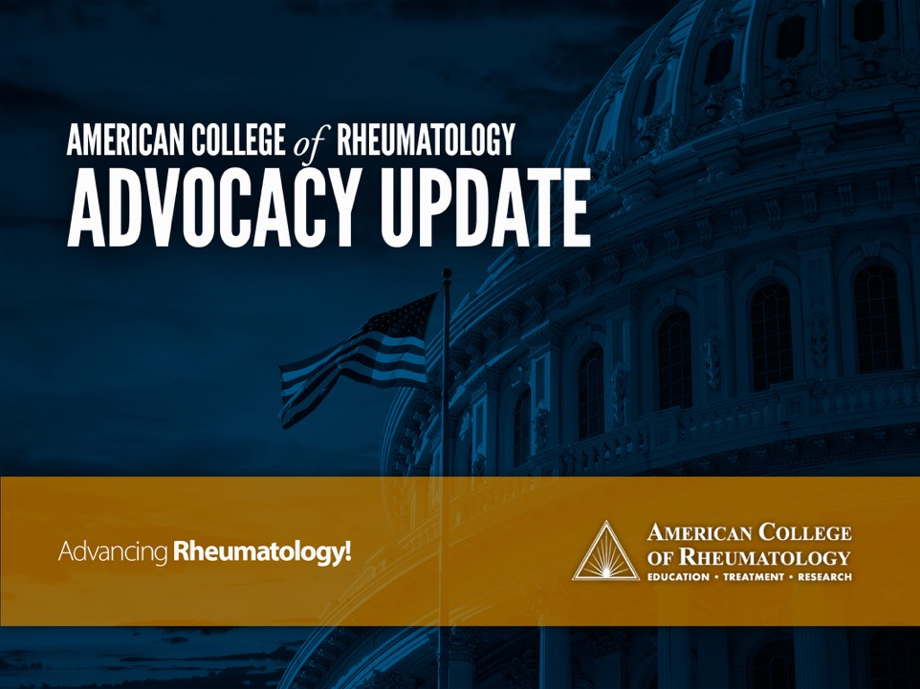
Washington Update: What’s the ACR Doing for Me?
3rd Annual Meeting, Alaska Rheumatology Alliance
Angus Worthing MD
Chair, ACR Government Affairs Committee
Alyeska Resort, Girdwood Alaska
March 23, 2019

Slide 2
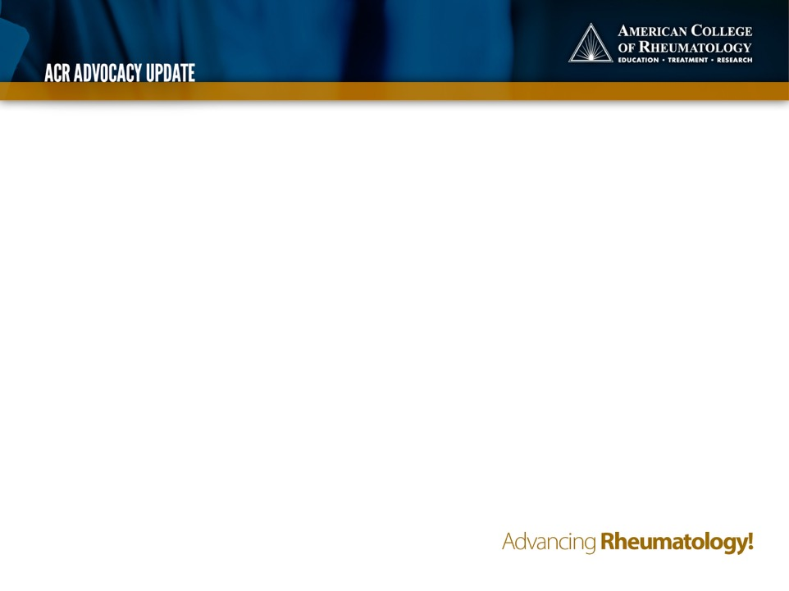
Agenda
ACR Advocacy overview
Washington Update
What does ACR do for our profession?
YOU Can Make a Difference – today!
Notes:
For those of you who heard me speak last year, I’m going to start differently this year by giving you an overview of ACR’s advocacy strategy
Then give you a similar update – some advocacy victories from last year, some new issues, some issues we still haven’t solved yet – and invite you to get involved – during the lecture, on your phone or laptop.

Slide 3
Agenda
ACR Advocacy overview
Washington Update
What does ACR do for our profession?
YOU Can Make a Difference – today!

Slide 4
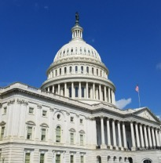
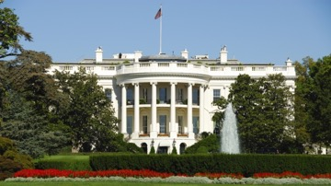
US Health “System”
Notes:
Let’s start with the basics
US federal government includes 3 branches. Two of them: Legislative branch (left) and Executive branch (right) are open to public input.

Slide 5
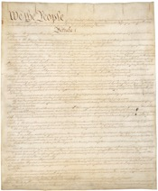

US Health “System”
Notes:
The Congress holds the power of the purse and appropriates money to health agencies.
It also writes laws which the President can sign or veto. System of checks and balances.

Slide 6
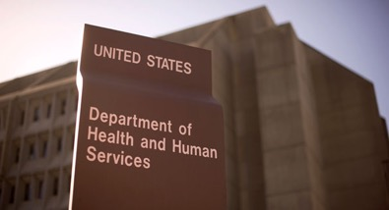
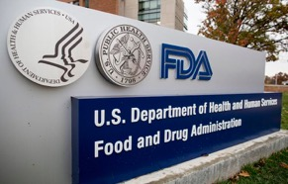

US Health “System”
Notes:
The executive branch enforces the laws by staffing agencies of bureaucrats that write regulations, and spends the money Congress appropriates.’

Slide 7
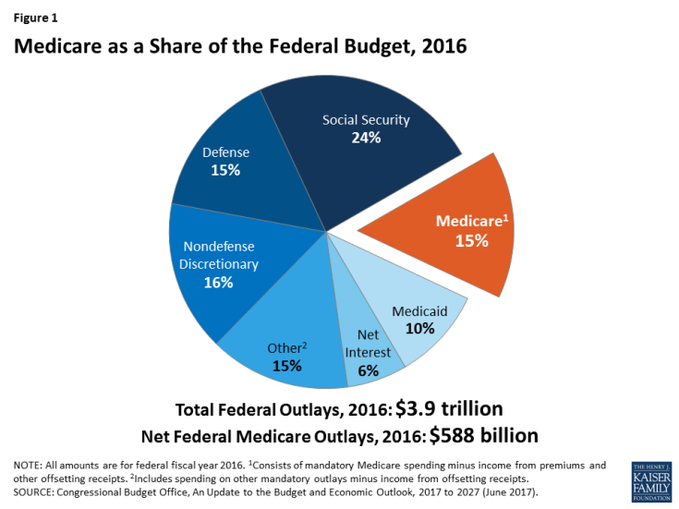
Cubanski and Neuman, Kaiser Fam Foundation 2017
Notes:
Speaking of Money. This is the 2016 US federal budget of $3.9 Trillion.
Orange call-out wedge is Medicare, representing $588 billion or 15% of the budget and Medicaid below it another 10%.
These programs together total 25% of the US federal govt spending. They are a similar percentage of health spending overall together with commercial insurance.
Needless to say, there are a lot of individuals and organizations telling the gov’t about what to do with that large slice of the pie.

Slide 8
FSMB.org 2016, and Battafarano et al 2018
Notes:
Meanwhile, rheumatologists represent a small sliver of US doctors. We are approximately 6000 (0.6%) of about 1 million physicians in the US

Slide 9

Notes:
Like a little fish in a big pond, we dream big.

Slide 10
“Never doubt that a small group of thoughtful, committed citizens can change the world; indeed, it's the only thing that ever has.”
Margaret Mead

Slide 11
Your ACR Practice and Advocacy Team
Rachel Myslinski, MBA – VP, Practice, Advocacy & Quality
Adam Cooper, MS – Sr. Director, Government Affairs
Kayla Amodeo, PhD – Director, Regulatory Affairs
Lennie Shewmaker, JD – Sr. Manager, Federal Affairs
Joseph Cantrell, JD – Sr. Manager, State Affairs
Antanya Chung, CPC, CPC-I, CRHC, CCP – Director, Practice Management
Meredith Strozier – Director, Practice Advocacy (insurance)
Janell Martin – Director, Registry Operations
Melesia Tillman – Specialist, Coding and Reimbursement
Tracy Johansson – Director, Registry Analytics
Norlita Brown – Specialist, Registries & HIT
advocacy@rheumatology.org
Notes:
11 of the ACR staff work tirelessly on your behalf to support rheumatologists and rheumatology professionals advocating across all the issues our profession faces. You can connect by email advocacy@rheumatology.org
Highlight Joseph Cantrell, Antanya Chung, Meredith Strozier, Janell Martin.

Slide 12
Government Affairs Committee 2019 Roster
Howie Blumstein, MD
Courtney Crayne MD
Ethan Craig MD
Bonnie Libman MD
Christina Downey, MD
Jessica Farrell, Pharm.D
Robert Jenkins, MD, PhD
Ryan Jessee, MD
Bharat Kumar, MD
Brian Loggins, BS, BBA, MBA
Victoria Menzies, PhD, RN
Christopher Morris, MD
Lisa Robbins, RN, BSN, CPNP
Tamar Rubenstein, MD
Roy Sampson, MD
Blair Solow, MD
Kristi Kuhn, MD, PhD
Kelly Weselman, MD
Angus Worthing, MD (Chair)
Notes:
Speaking of hard-working: these volunteers include members from across the country and all types of ACR members
I encourage you to apply for a volunteer position – a 3-year term (1-year for fellows)

Slide 13
ACR’s Overarching Advocacy Pillars:
  Patient Access to Rheumatology Care
  Patient Access to Treatments
  Research, Training & Workforce
Notes:
Generally, rheumatology advocacy addresses 3 main issues. Access to care & treatments, and strengthening our research, training and workforce.

Slide 14
Select Rheumatology-related Policy Issues
Workforce/GME/Training
Prior Authorization
Step therapy
Biosimilars: notification, naming, education
MACRA (MIPS/APM)
PBM reform
Drug price reforms
Research funding
Increase value of E/M
Complex infusion codes
Pediatric Access
Part B Sequester
Restore DXA
Protect MSUS
Access to Care
Network Adequacy
Tier 4 coinsurance
Notes:
Rheumatologists have a large number of issues affecting us and our patients. I’ll do a deep dive on a few examples of what ACR is doing right now on a few of these.
But first: as a small fish in a big pond of US health care, and a large list of critical issues:
How we leverage our voice?

Slide 15
Leveraging ACR’s voice

Slide 16
Leveraging ACR’s voice
Workforce/GME/Training
Prior Authorization
Step therapy
Biosimilars: notification, naming, education
MACRA (MIPS/APM)
PBM reform
Drug price reforms
Workforce gap
Research funding
Increase value of E/M
Complex infusion codes
Pediatric Access
Part B Sequester
Restore DXA
Protect MSUS
Access to Care
Network Adequacy
Tier 4 coinsurance

Slide 17
Coalitions
Grassroots emails
Op-Eds, press reports
Capitol Hill Fly-in, A101
RheumPAC
AMA
Leveraging ACR’s voice
Workforce/GME/Training
Prior Authorization
Step therapy
Biosimilars: notification, naming, education
MACRA (MIPS/APM)
PBM reform
Drug price reforms
Workforce gap
Research funding
Increase value of E/M
Complex infusion codes
Pediatric Access
Part B Sequester
Restore DXA
Protect MSUS
Access to Care
Network Adequacy
Tier 4 coinsurance
Notes:
How we leverage our voice – given many issues, small society/resources. INCLUDE A101 in fly in –educating next generation of rheumatologists to advocate for our profession.
Also, our strategy is issue-based, so we support issues or parts of legislation, and stick to what matters to rheumatologists, to avoid burning bridges politically.
There are many ways, large and small, to get involved

Slide 18
Agenda
ACR Advocacy overview
Washington Update
What does ACR do for our profession?
YOU Can Make a Difference – today!

Slide 19
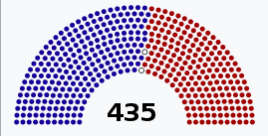
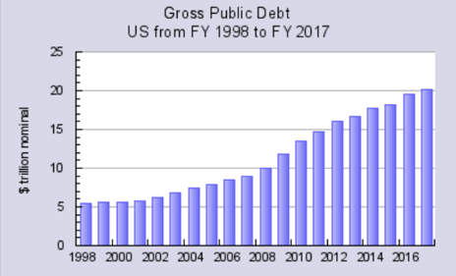
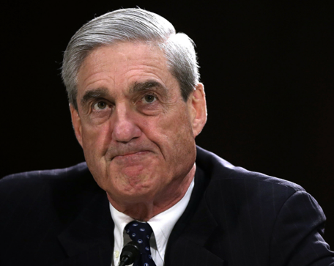
Notes:
The landscape in Washington DC right now (Feb 2019) is dominated by these 3 items:
House changed hands to Dem control and thus oversight of the Administration and possibly more interest in entitlements
Special Counsel Robert Mueller’s investigation and indictments of administration officials
$20 Trillion debt estimated to grow by $1T per year!

Slide 20
Congress
“The Ι Word”
Budget season
Drug pricing
Notes:
Recent events like the shutdown and the possibility of presidential impeachment have increased the sense of partisanship in Washington.
The newly Democratically-controlled House has chosen its new committee leaders, and this includes Rep Anna Eshoo as chair of the Energy and Commerce Health Subcommittee who knows ACR issues well as a former chair of the Congressional Arthritis Caucus.
Each spring is budget season in which Congress debates appropriations. ACR is currently asking for money to be earmarked for an arthritis research program at the Pentagon

Slide 21

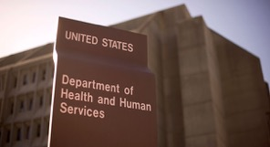


Trump Administration
Indictments & Subpoenas
Border Wall
2020
Drug pricing
Notes:
Again, partisanship. Will anything get accomplished with all the partisanship around indictments, the border wall, and the upcoming 2020 elections?
Drug pricing is on the agenda for both Congress and the White House, and both seem to agree on 2 initiatives: capping Medicare beneficiaries OOP costs, and ending manufacturers’ use of “pay for delay” to prevent use of lower cost generics.

Slide 22
Agenda
ACR Advocacy overview
Washington Update
What does ACR do for our profession?
YOU Can Make a Difference – today!

Slide 23
Recent ACR “Wins”
E/M code cuts postponed and modified
No MIPS adjustments on Medicare drug reimbursement
MSK US reimbursement cuts dampened
No annual cap on physical/rehab therapy
IPAB repealed
Medicare: 50% less penalties (’18); ePA will be an option
PBM “gag clauses” prohibited
DACA protected: could provide care for 100K Americans
ACR LEAD
Notes:
For those of you who attended last year’s meeting, there’s good news on some of the initiatives.
Last year I told you about how ACR was pushing to eliminate PBM “gag clauses”, and establish an option for Electronic prior auth in Medicare prescriptions, and extend DACA protections because of the many child immigrants going into medical training. We won all these battles and more.

Slide 24
Recent ACR Insurance Subcommittee “Wins”
Cancelled policy downcoding administration of biologic drugs (UHC)
Delayed policy cutting reimbursement for E/M services when billed with modifier 25 (UHC)
Delayed policy to discontinue reimbursement of consultations (UHC)
Fixed system error causing inappropriate denials for steroid injections (Aetna)
Notify ACR of coverage problems: Advocacy@rheumatology.org, or fill out a health plan complaint form (search “ACR insurance”)

Slide 25
Selected Federal Issues

Slide 26
Drug Price Proposals
Trump Administration:
International Drug Pricing Model
Step Therapy in Medicare Advantage
Ending rebates to PBMs
Congress
Hearings with drugmakers, PBMs
Considering capping OOP costs, stopping “pay for delay”
Notes:
ACR has met with Sec Azar and his top lieutenants regarding Step Therapy and the Intl Drug Pricing Model.

Slide 27
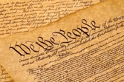
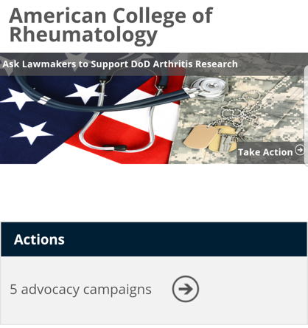
First Amendment Exercise
Search “Rheum Legislative Action Center”
Send pre-written letters
Find legislators
Find legislation
Sign up for alerts
Notes:
What can you do if you hear about an issue in the paper, or on Twitter, or when your prescription gets blocked by insurance?
Go to the ACR legislative action center and quickly email your members of Congress – I invite you to do this during this lecture!
Current letters at the website: DOD research “ask”, Osteoporosis screening (check for updates) and a blank template for you to write about your issue/concern
When you see this picture of the constitution in this slide deck, think about the first amendment right to petition government for a redress of grievances, and email Congress!

Slide 28
DXA Reimbursement
Increasing Access to Osteoporosis Testing Act (S 283)
Bipartisan support
Would raise Medicare reimbursement to $98 for DXA
Anticipate a House companion bill
Please email Senators Murkowski and Sullivan now!

Slide 29
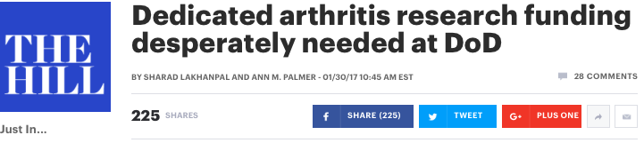
Biomedical Research
  ACR initiative: earmark $20 Million/year dedicated to arthritis research at Department of Defense
  Email your members of Congress today!

Slide 30
Workforce
Hayley McCloud
Sr. Manager of State Affairs
hmccloud@rheumatology.org

Slide 31
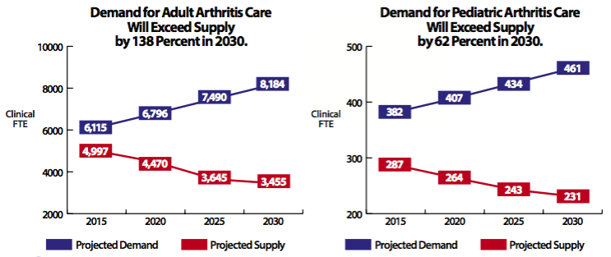
Demand for adult arthritis care will exceed supply by 138% in 2030 and rheumatologists are concentrated in cities.

Slide 32
Workforce – ACR Supports:
Additional residency positions
Funding for rheumatology fellowship positions
Attracting pediatricians to rheumatology
Loan repayment for rheums in underserved areas
  Peds rheum: Nat’l Health Service Corps
  State initiatives (Georgia)
Hayley McCloud
Sr. Manager of State Affairs
hmccloud@rheumatology.org

Slide 33
Step Therapy Reform
Would create national exception process if step protocol drug expected to fail, cause A/E or disability
Reintroduce HR 2077 by Reps Wenstrup and Ruiz (Podiatrist and Physician)
Create Senate companion bill
Look for an email alert!
Notes:
(email alert coming soon as of Feb 2019)

Slide 34

PBM Transparency
The issues:
  Incentives: Rebates push prices up, dictate formularies
  Consolidation: 3 companies have 70% of prescriptions
  Secrecy
  May prevent biosimilars cost-savings
Goals:
  Make PBMs more transparent
  Improve access to treatment
Wins:
  Proposal to eliminate rebates in Medicare NEW
  Pharmacist “gag rule” banned in 2018
  Arkansas 1st state to regulate PBMs
  Virginia transparency bill passed
Notes:
To review the issue I spoke to you about last year, the issue is rebates and …
ACR co-convened ATAP with CSRO & others to shed light on the issues of PBMs.

Slide 35
What’s ACR doing about MACRA in 2019?

Slide 36
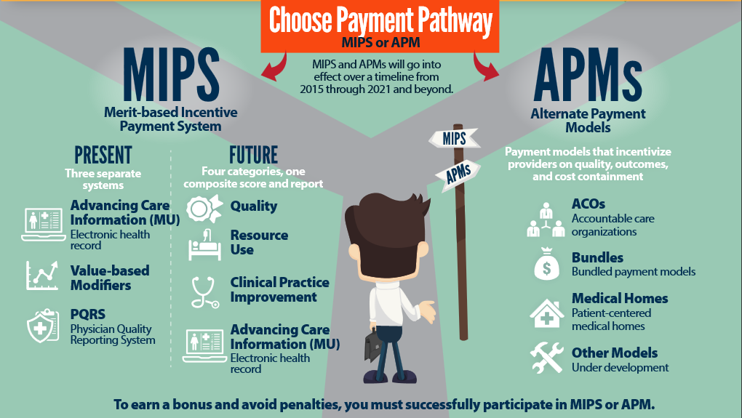
MACRA: Medicare’s 2 Pathways. Since 2017
Notes:
MACRA is Medicare’s way of modifying the fee for service system since 2017, by changing FFS to “MIPS” which adjusts reimbursement based on a score for each physician or practice that is based on quality, resource use (now called Cost), Clinical Practice Improvement, and ACI (now called Promoting Interoperability).
To avoid potentially negative adjustments, physicians can join an APM.

Slide 37
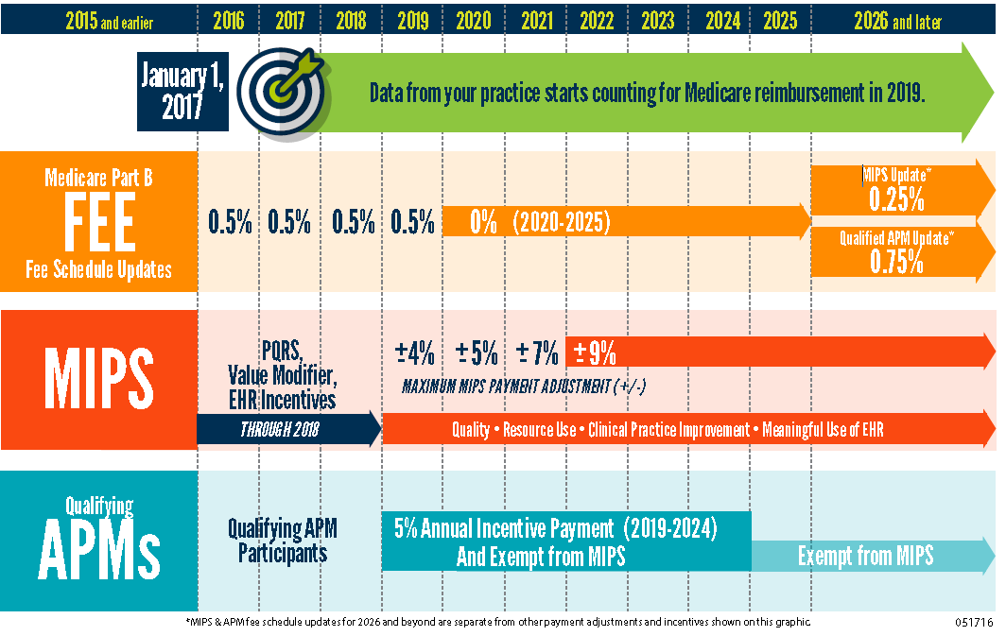
0.25%
_____
Notes:
Compared to MIPS, with adjustments based on performance of +/-4% in 2019 based on 2017 performance, APM track offers 5% bonus 2019-2024
Consider what a 9% cut means to a hypothetical entity with 70% overhead, in which a doctor takes home 30% of reimbursement. Say, 30 cents on the dollar. Reducing the total reimbursement 9%, or 9 cents, brings hypothetical reimbursement to 91 cents, and with overhead stable at 70 cents, doctor takes home only 21 cents compared to 30 cents = 30% cut.
Then, there will be a difference in yearly fee schedule updates for the 2 tracks starting in 2026

Slide 38
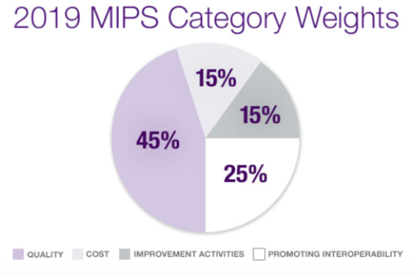
Performance threshold
2017: 3 points
2018: 15 points
2019: 30 points
Notes:
Quality is 45%
Cost and Improvement Activities each 15%
PI 25%
For those in MIPS: Points from 4 categories add to one composite score. You avoid cuts with a score at or above the performance threshold (3 points in 2017, 15 in 2018, 30 in 2019), and get extra bonus above an exceptional performance threshold.

Slide 39
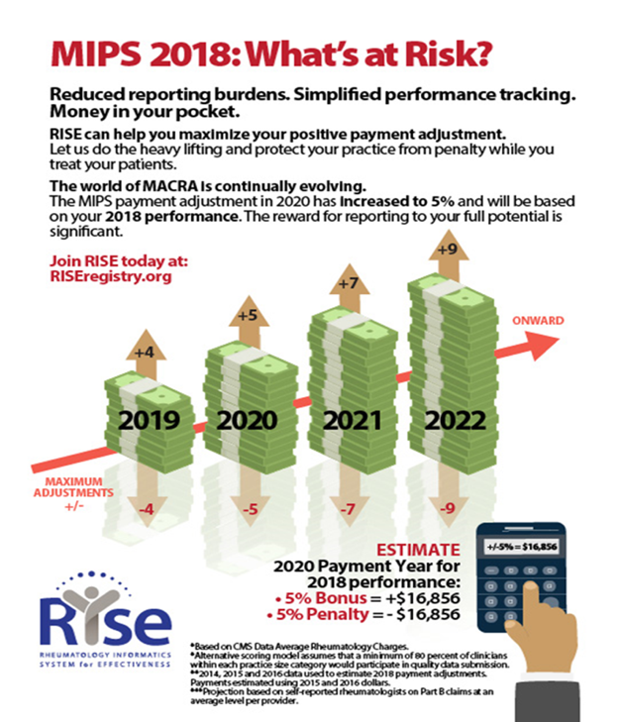
Rheums can use
the ACR RISE
Registry to report
to MIPS!
advocacy@rheumatology.org
Notes:
A MIPS adjustment of 5% could garner a reward or penalty of $16,000 in 2020 based on 2018 performance. 2019 adjustments are higher with up to + or – 7%.
All who submitted through RISE in the first year earned exceptional threshold bonus with access to additional reward money.

Slide 40
ACR’s Medicare Goals:
Reduce impact of MIPS cost measure
Create a workable APM track for RA
Prevent PBMs from controlling Part B drugs
Protect MSK ultrasound

Slide 41
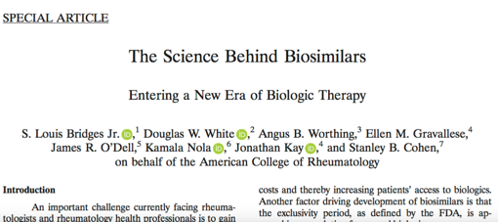
State Update: Alaska
Themes in other states:
PBM & Step therapy reform
Biosimilar substitution
Alaska biosimilars law
took effect Jan 1
Substitution requires FDA interchangeability certification
Requires 3 day physician notification
“Dispense as written” blocks substitution
Notes:
43 states have PBM legislation on the books
29 have banned the “gag clause”
23 have limited “claw-backs”

Slide 42
State Update: Alaska
NEW Active Legislation in 2019
  HB 13-Medicaid work requirement
    Would require Department of Health and Social Services to seek an 1115 waiver to implement Medicaid work requirements
  HB 89 - Opioid prescription notification requirements
    Would require prescribing physicians to give written and oral information to patients on the dangers of opioids, & possible alternatives when prescribing
  SB 93 - Would expand access to state medical loan forgiveness program
Notes:
Deleted
HB 17-Repeal certificate of need for health care facilities

Slide 43
Agenda
ACR Advocacy overview
Washington Update
What does ACR do for our profession?
YOU Can Make a Difference – today!

Slide 44

Why Advocate?
  Exercise your first amendment rights: “petition government for redress of grievances!”
  We are in an era of change and tumult. Democracy & institutions require educated input
  Extend the “do no harm” ethic to prevent government from harming patients
  It’s fun!

Slide 45

Menu for Making a Difference
Get involved with your state/local Rheumatology society
Join the AMA
Invest in RheumPAC
Use ACR Legislative Action Center to email Congress
Call, write letters, use social media
Invest in Rheumatology Research Foundation (training $)
Get your patients and friends involved (simpletasks.org)
Come to Capitol Hill this September!

Slide 46
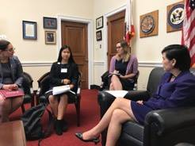
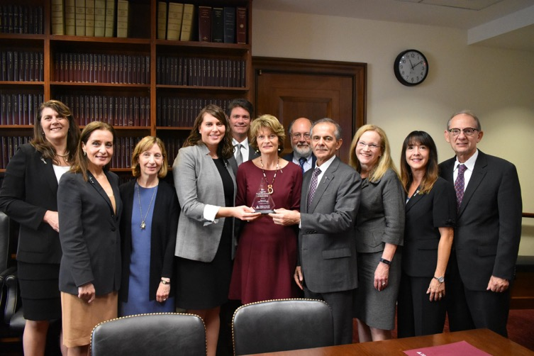
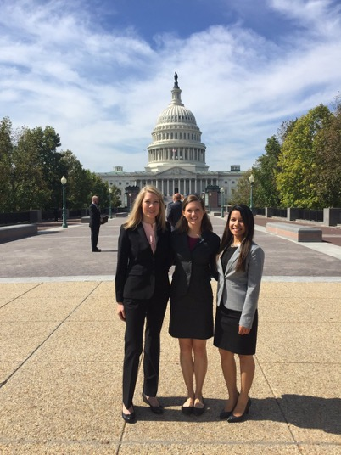
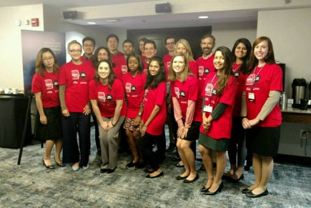
Notes:
Some pics of people having a great time advocating for our profession and our patients on Capitol Hill.
Middle: Dr. Sarah Doaty and Dr. Sharad Lakhanpal give 2017 award for leadership in public service to Sen Lisa Murkowski (AK)

Slide 47
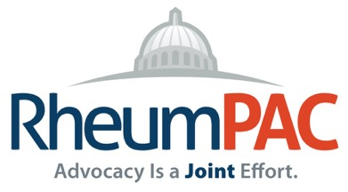

Why is a PAC important
for rheumatology?
Relationship building with 100 new members, leaders, and staff
Seat at the table with key members of Congress
Educate those who will make decisions impacting rheumatology
ACR strategic plan: 10% participation (currently 3-4%)
Notes:
I encourage you to participate in the PAC.
ACR’s strategic plan includes a goal of 10% of ACR members investing in the PAC. Only 3 to 4% have contributed in recent years.

Slide 48
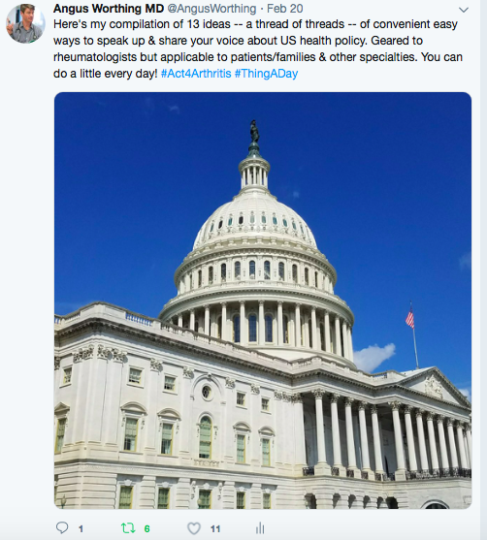

Discussion
Review my tips at #ThingADay
advocacy@rheumatology.org

