Slide 1
Positioning Biologic Therapy in IBD
Austin T. Nelson, M.D.
Alaska Digestive and Liver Disease

Slide 2
Financial Disclosures
None

Slide 3
Case Study #1
26yo male presents with 9 month history of abdominal pain
10 pound weight loss
8-10 bowel movements per day (all loose in nature)
Occasional hematochezia
Sporadic joint pains that have been new onset in nature over the previous month
Mild anemia (hgb of 11)
Odd eye inflammation several years ago treated with steroids

Slide 4
Case Study #1
Blood work:
Hgb 11, hct 35, albumin 2
ESR 2 (normal)
CRP 45
Vitamin D of 18
Ferritin 15, TIBC elevated

Slide 5
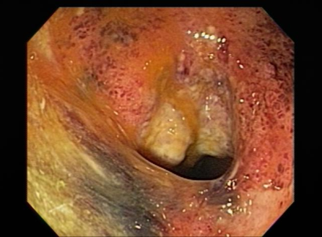
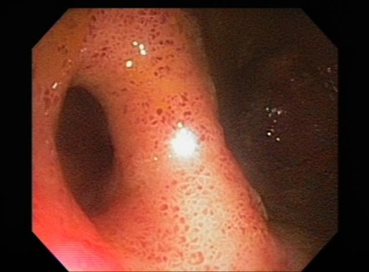
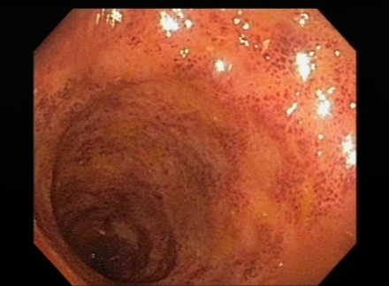
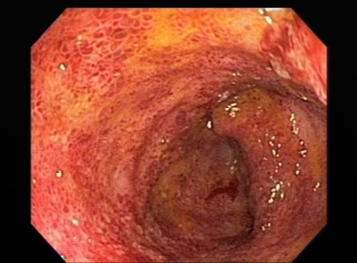
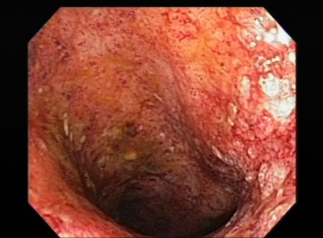
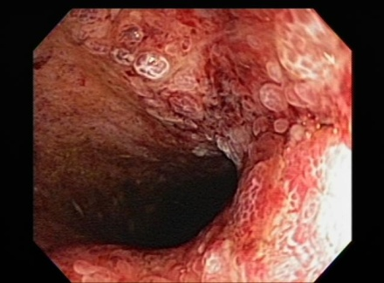
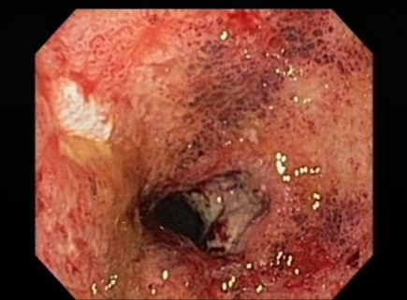
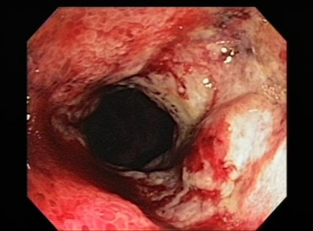
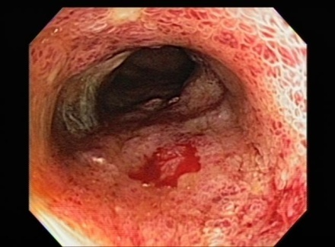
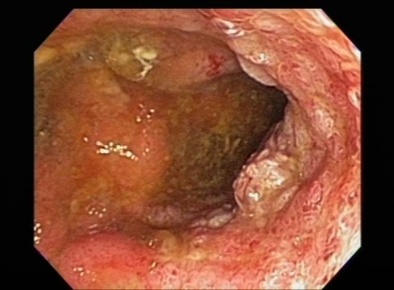
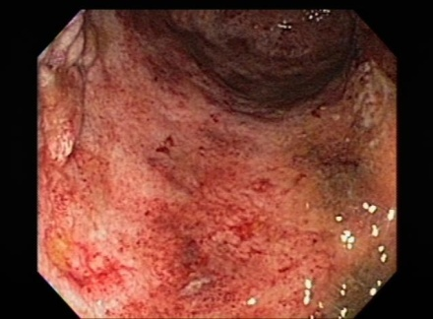

Slide 6
Inflammatory Bowel Disease (IBD)
Three Subtypes:
Crohns Disease
Fistulizing
Fibrostenotic
Ulcerative Colitis
Location Dependent
Indeterminate Colitis
Can’t make up its mind!

Slide 7
Ulcerative Colitis (UC)
Chronic condition of relapsing/remitting episodes of inflammation to the mucosal layer of the colon
Diagnosis: diarrhea for > 4 wks, active inflammation on endoscopy, chronic changes on biopsy
Rectum is always involved, confluent to some point in the colon
Symptoms: BRBPR/bloody diarrhea, diarrhea, urgency, cramps/pain
Labs: IDA, elevated ESR/CRP/calprotectin/plt count, elevated WBC, low albumin

Slide 10
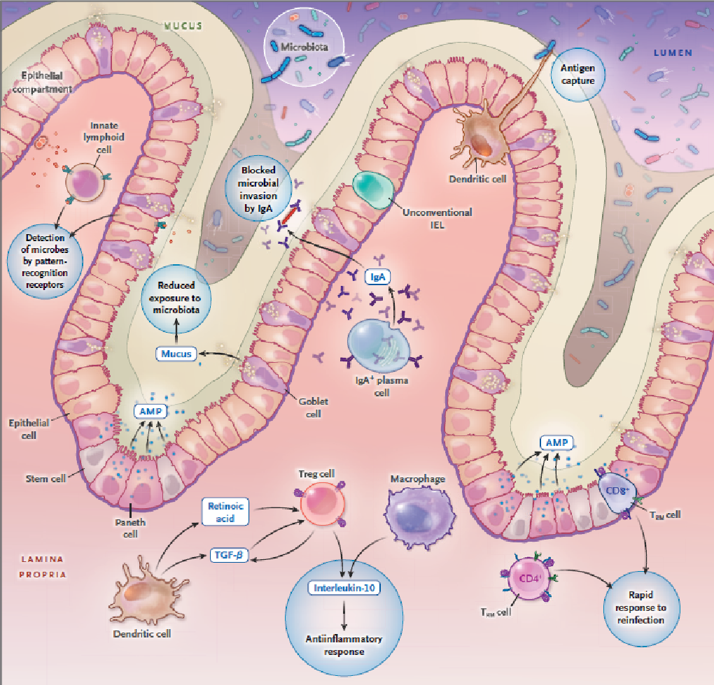
WHY???
Chang JT, NEJM 2020; 383:2652-64
Notes:
tHIS gives me a headache just as much as anyone! What does it mean? Well…this is the “theories” behind development of IBD
AMP – antimicrobial peptides
Only 8-10% of corohns disease variance can be attributed to known genetic issues and only 4-5 % for UC
Humans are colonized by trillions of bacteria, virus, fungal, etc. Distal ileum and colon contain massive amouns of these organizms.
Dysregulation of good bacteria (dysbiosis) and infiltration through the epilthelial cells causes an immune response.
Trials have shown CD and UC have a reduced total number, diversity, and richness of microbial species.
Fecal material from IBD patients have conferred incr3eased suspecptbilit to colitis in germ free mice as compares to mice that received fecal material from healthy subjects
Immune system;
Innate vs humoral immunity; systemic vs. local
Mucosal immune system – largest component of the immune system (75% of all ymphocytes and produce the majoriy of immunoglobulin in healthy persons)
Innate – cells that express receptors that detect microbial products or patterns, macrophages, dendritis cells,
Humoral (adaptive) – b cells and t cells
IBD has decreased Iga in mucosal compared to health individuals.

Slide 11
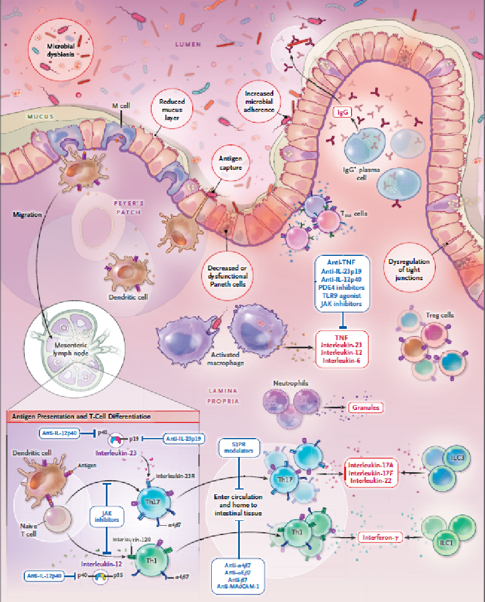
WHY???
Chang JT, NEJM 2020; 383:2652-64

Slide 12
Case Study #2
31yo female presents with 3 year history of abdominal pain
Alternating bowel habits to include constipation and diarrhea
Never had any hematochezia
Sporadic joint pains that have been new onset in nature over the previous month
Normal hgb (mild macrocytosis)
History of psoriasis and followed by dermatology with topical steroid treatment

Slide 13
Case Study #2
Blood work:
Hgb 13, MCV of 100
ESR 2 (normal)
CRP 15
Vitamin D of 20
Ferritin 20, TIBC elevated
Fecal calprotectin of 400
Mild B12 deficiency

Slide 14
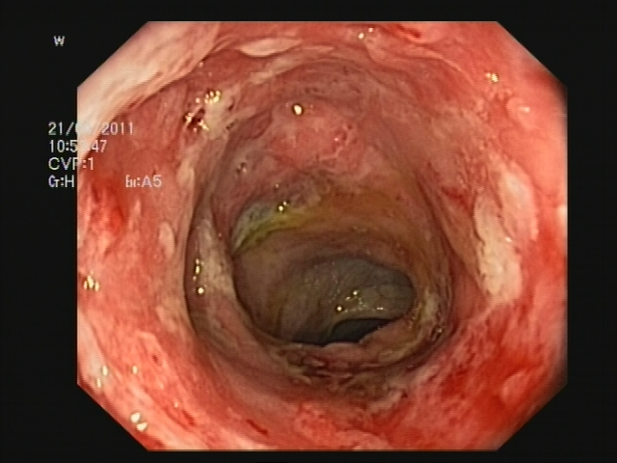
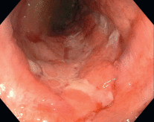

Slide 15
Crohn’s Disease
Chronic condition of relapsing/remitting episodes of transmural inflammation of the GI tract
Can affect any portion of the gut
Clinical manifestations: depends on location
Clinical manifestations: depends on location
Fistulas, abscesses, weight loss, systemic
Extraintestinal manifestations:
Arthritis, eye involvement, skin disorders, PSC, renal stones, osteoporosis, B12 def….

Slide 16
Crohn’s Disease
Distribution
Small bowel involved (80%)
Distal ileum only (33%)
Ileocolic (50%)
Only colon (20%)
*Rectal sparing (50%)
Perianal disease (33%)
Mouth, gastroduo (5-15%)
Esophagus, prox SB (< 5%)

Slide 20
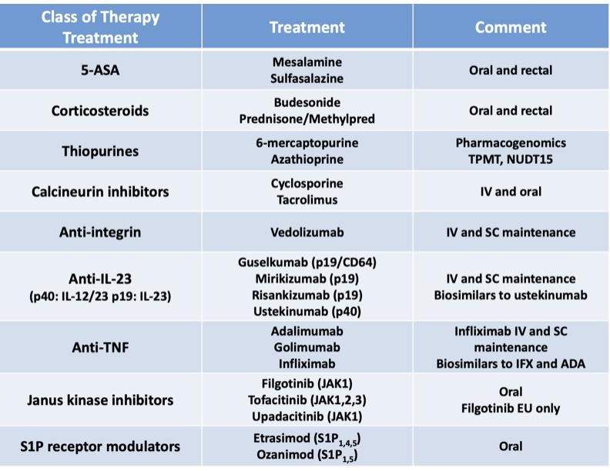
FDA Approved therapies 2025

Slide 21
α4β7 inhibition (anti-adhesion)
Medication: vedolizumab (CD and UC)
Dose: 300 mg IV at 0, 2, and 6 weeks, then every 8 weeks thereafter
SC maintenance now approved
MOA
Binds to α4β7-integrin receptor and blocks interaction with MAdCAM-1 on vascular endothelial gastrointestinal cells (not brain)
Inhibits the movement of memory T-lymphocytes across the endothelium into inflamed gastrointestinal tissue
Immunogenicity:
Less than TNF therapy
~ 4% of total population had + ADA at any point
Advantages: “gut selective” = safety advantage
Disadvantages: “gut selective” = will not work for concurrent autoimmune disease (e.g. RA, psoriasis)
Safety
NO BOXED WARNING
Excellent safety profile
Increased risk of infection (no association with TB)
Low rates of infusion reactions

Slide 22
IL 12/23 inhibition
Medication: ustekinumab (CD and UC)
Induction:
Up to 55 kg = 260 mg
Greater than 55 kg to 85 kg = 390 mg
Greater than 85 kg = 520 mg
Maintenance: Pre-filled syringe, 90mg SubQ every 8 weeks
MOA:
Human IgG1-kappa monoclonal antibody that binds to the p40 subunits of the interleukin (IL)-12 and IL-23 cytokines which are involved in inflammatory and immune responses
Immunogenicity:
Less than TNFs
~2.3% of total population had + ADA at any point
Safety
NO BOXED WARNING
Excellent safety profile
Increased risk of infection (no association with TB)
Low rates of infusion and injection reactions

Slide 23
IL 23 inhibition
Medication:
Mirikizumab, guselkumab, risankizumab – CD, UC options
MOA:
Human IgG1 monoclonal antibody which selectively binds to the p19 subunit of interleukin (IL)-23, thereby inhibiting its interaction with the IL-23 receptor, resulting in inhibition of the release of proinflammatory cytokines and chemokines
Immunogenicity:
Less than TNFs
Safety
NO BOXED WARNING
Excellent safety profile
Increased risk of infection (no association with TB)
Low rates of infusion and injection reactions
Transient elevated liver enzymes

Slide 24
S1P
Medication:
Ozanimod, Estrasimod
Etrasimod – No dose titration but similar monitoring and skin exam.
Indication: moderate to severe UC
MOA: causes sequestration of lymphocytes in lymph nodes. Traps some types of activated lymphocytes in lymph nodes, preventing migration to peripheral tissues, including intestinal tissue
Immunogenicity: Theoretically not an issue, but there can be loss of response/inability to recapture
Monitoring:
ECG prior to start
CBC with differential
Fundoscopy In high risk patients (history of diabetes, uveitis, or macular edema)
Avoid in:
Significant cardiovascular disease
Monoaminoxidase use
Baseline lymphocytes <0.8 x 10^9/L
Safety:
NO BOXED WARNING
Monitor for lymphopenia (expected)
45% reduction
37% with <0.5 x 10⁹/L
~1% <0.2 x 10⁹/L
Typically recover after 8 wks
Absolute lymphopenia did not correlate with increased risk of serious infections
Infection
Headache
Liver test elevation
Bradycardia
Macular edema - rare
Hypertensive crisis - rare
Unknown risks in pregnancy
Avoid
Notes:
sphingosine 1 phosphate

Slide 25
TNF-α antagonist
Medications:
CD: infliximab, adalimumab, certolizumab pegol
UC: infliximab, adalimumab, golimumab
MOA:
Binds TNF-α, blocks interaction with the p55 and p75 cell surface TNF receptors
Immunogenicity
10%-20% risk, contributes to loss of response or intolerance
Can minimize with concomitant immunomodulator, induction dosing, avoiding breaks in therapy
IV vs SC
IV: infliximab: Infrequent dosing, FDA approved dose optimization, Requires infusion at facility or home infusion, Risk of infusion reaction
SC Inflix: lower antibody rates, more stable drug levels
SC: certolizumab, adalimumab, golimumab
Safety
Increased risk of infection
Boxed warning
Reactivation of latent TB
Worsening of existing heart failure or demyelinating disease
Psoriasis-like rash

Slide 26
JAK
Medications:
Tofacitinib (UC)
10 mg twice daily for at least 8 weeks, then can decrease to 5 mg BID (but few patients do well on 5 mg)
Upadacitinib (UC and CD)
45 mg once daily for 8 weeks (UC) or 12 weeks (CD); maintenance: 30 mg once daily (15 mg maintenance available, but few patients do well on this dose)
FDA guidance: must have intolerance or inadequate response to ≥1 TNF
MOA: Inhibitor of Janus Kinases (JAKs) which results in decreased gene transcription and production of cytokines
Efficacy
May have an advantage in very ill patients with low albumin who may clear biologic therapies rapidly
Can work quickly
Immunogenicity: Theoretically not an issue but can have loss of response/inability to recapture response
Watch for acne and paradoxical arthritis and opportunistic viral infections
Safety
Risk of infection, particularity Shingles
Recommend Shingrix
Increased lipids; but ratio predictive of cardiovascular risk remains relatively stable
MACE, VTE risks
Black box warning
Malignancy risk
Avoid in tobacco users
Headache
Liver toxicity
Unknown risks in pregnancy
Avoid

Slide 27
FDA approved biologic/small molecule therapies
Anti-TNF therapy (cytokine based therapy)
Infliximab (UC/CD) – mult biosimilars, SQ maintenance
Adalimumab (UC/CD) mult biosimilars
Certolizumab (CD)
Golimumab (UC)
Anti-integrin therapy (prevents lymphocyte trafficking in blood vessels)
Natalizumab (CD) – unlikely to be used
Vedolizumab (UC/CD, Pouchitis in EU; SQ approved for UC and CD)
IL 12/23 (p40) inhibition (cytokine based therapy)
Ustekinumab (UC/CD) – Multiple biosim coming in 2025
S1P inhibition (prevents egress of activated lymphocytes)
Ozanimod (UC), Etrasimod (UC)
IL 23 (p19) inhibition (cytokine based therapy)
Risankizumab (CD, UC), Mirikizumab (UC, CD coming), Guselkumab (CD and UC coming)
Jak inhibition
Tofacitinib (UC), Upadacitinb (UC/CD)

Slide 28
IBD Treatment History
1859: first case of Ulcerative colitis described
1970s: sulfasalazine
1980s: thiopurines
1998: infliximab (CD)
2005: infliximab (UC)
2007: adalimumab
2008: natalizumab
2009: certolizumab
2014: vedolizumab
2016-present: 9 variations of new small molecule and IBD therapy

Slide 29
Where to begin?
Mild Ulcerative Colitis/proctitis:
Can be managed with anti-inflammatory therapy such as mesalamine based products.
37% of patient on maintenance therapy with mesalamine will relapse in 6-12 months
40% of patients will isolated proctitis will progress to full colitis

Slide 30
What is the best advanced therapy option?

Slide 31
Notes:
Huge treatment changes identified by these two landmark studies.
T
His generated the “top down” approach vs. bottom up approach?
What do we do now? Hit them hard up front.

Slide 32
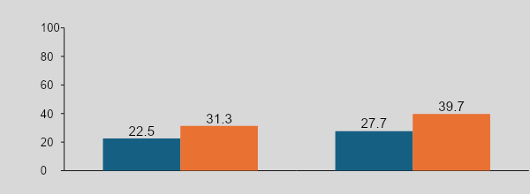
VARSITY Trial
Adalimumab vs Vedolizumab in moderate to Severe UC
Adalimumab (n=386) Vedolizumab (n=383)
Clinical remission | Endoscopic improvement | Corticosteroid-free clinical remission
Sands BE et al. N Engl J Med. 2019;381:121501226.
Notes:
Very few head to head studies looking at two advanced therapy options that includes biologic therapy/small molecule therapy
Clinical remission, endoscopic remission all better with Vedo

Slide 33
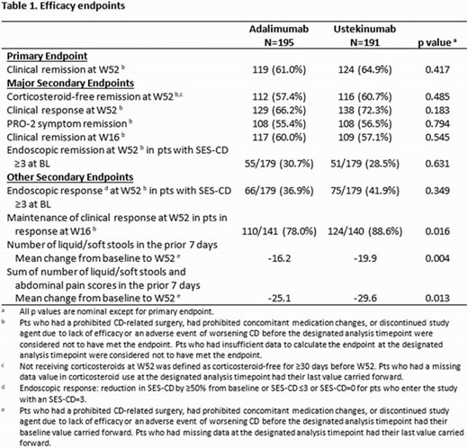
SEAVUE (CD with ustekinumab vs adalimumab)
Notes:
comparative study in CD with ustekinumab vs adalimumab - 2022

Slide 34
SEQUENCE study NEJM 2024 - Risankizumab vs Ustekinumab in Crohns disease (mod to severe)
End Point | Risankizumab (N=255) | Ustekinumab (N=265) | Adjusted Difference† | P Value†
 | percent (95% CI)‡ |  | percentage points (95% CI)
Primary end points
Clinical remission at week 24§ | 58.6 (50.1–67.1) | 39.5 (31.3–47.7) | 18.4 (6.6–30.3)¶
Endoscopic remission at week 48‖ | 31.8 (26.1–37.5) | 16.2 (11.8–20.7) | 15.6 (8.4–22.9) | P<0.001
Secondary end points
Clinical remission at week 48** | 60.8 (54.8–66.8) | 40.8 (34.8–46.7) | 19.7 (11.3–28.1) | P<0.001
Endoscopic response at week 48†† | 45.1 (39.0–51.2) | 21.9 (16.9–26.9) | 23.3 (15.4–31.2) | P<0.001
Endoscopic response at week 24†† | 45.2 (39.1–51.3) | 26.4 (21.1–31.7) | 18.9 (10.9–26.9) | P<0.001
Glucocorticoid-free endoscopic remission at week 48‖‡‡ | 31.4 (25.7–37.1) | 15.5 (11.1–19.8) | 15.9 (8.8–23.1) | P<0.001
Glucocorticoid-free clinical remission at week 48**‡‡ | 60.8 (54.8–66.8) | 40.4 (34.5–46.3) | 20.1 (11.7–28.4) | P<0.001
Notes:
In patients with moderate-to-severe Crohn’s disease who had had an inadequate response to anti-TNF therapy or unacceptable side effects with such therapy, risankizumab was noninferior to ustekinumab with respect to clinical remission at week 24 and superior with respect to endoscopic remission at week 48. No new safety risks were identified in association with risankizumab in this trial.

Slide 35
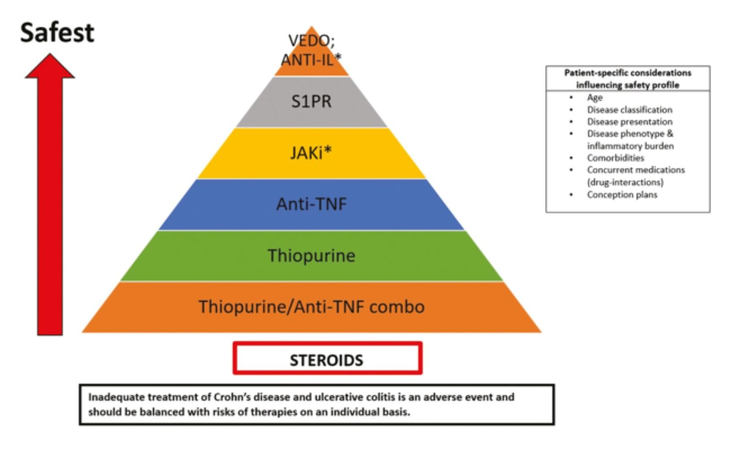
Bhat et al. Inflamma bowel Disease 14 Jul 2023
Notes:
Key thing to consider is the risk of disease not being under control is much greater than any medications.

Slide 36
Relative Efficacy of Advanced Therapy for UC
(endoscopic data)
Upadacitinib/Tofacitinib
Higher Efficacy
Guselkumab, mirikizumab, rizankisumab
vedolizumab, ustekinumab, infliximab
Increasing relative Efficacy
Adalimumab, ozanimod, etrasimod
Lower Efficacy
Notes:
All efficacy data is based on different trials, keep in mind, there are very few that compare each other naive patients. Trials also have at times different primary and secondary endpoints so very hard to make a determination

Slide 37
Relative Efficacy of Advanced Therapy for CD
(endoscopic data)
Rizankisumab/Guselkumab
Higher Efficacy
Upadacitinib, ustekinumab, infliximab, mirikizumab
Increasing relative Efficacy
Adalimumab, Vedolizumab
Lower Efficacy

Slide 38
Ruben, D. ACG 2024

Slide 39
Patient Specific Considerations
Heavy Disease Burden (high CRP, low albumin, extensive bowel involvement). Consider small molecule therapy over biologic.
Previous TNF failure - predicts lesser response independent of future mechanism
MS or CHF - Avoid TNF inhibitors
MS - consider S1P to treat both diseases with one drug
Cardiac disease - avoid JAK and possibly S1P
Active Smoking - avoid JAK
History of melanoma - avoid TNF inhibitors
Pregnancy or imminent pregnancy - no JAK or S1P
Notes:
fetal malformations with JAK and S1Ps

Slide 40
Back to the Cases…
Case 1:
26yo male with newly diagnosed UC (moderate to severe w/low albumin)
Small molecule therapy with JAK ideal
However, TNF failure needed first…
Other considerations as first line: vedolizumab, infliximab, IL-23
Infliximab started (remote history of uveitis with arthritis)
Clinical improvement after 2 months (needed steroids up front)
Repeat scope at 1 year mark with improvement but mild disease activity

Slide 41
Case 1 continued…additional options
Vedolizumab good option (perhaps better) if no h/o arthritis or uveitis
IL12/23, IL 23- good option but with uveitis history preferred therapy TNF inhibitor with infliximab
Repeat scope at 1 year mark with mild activity
Options:
Dose optimize (antibody levels/drug levels)
Add azathioprine (possible addition up front)
Switch to JAK

Slide 42
Back to the Cases…
Case 2:
31yo female with newly diagnosed ileal crohns disease and a history of psoriasis treated with topical therapy
Given history of psoriasis, decision was made to treat with rizankisumab
Clinical improvement at 4 weeks
Repeat scope at 1 year with stricture at the IC valve but no active inflammation present

Slide 43
Optimizing Success
Open communication with patient regarding expectations
Treatment is a journey, not a destination
Back up plans identified if insurance denial or treatment failure
Understanding phases of treatment (induction, remission)
Health care coordinator to assist with PA, insurance specific plans/failures, coordination with pharmaceutical companies
Long term plan - nearly every advanced therapy I start always begins with “how long will I be on this?”
Adherence to therapy is key…logistical challenge with infusion, SC, oral, etc.

Slide 44
Summary
IBD therapy with dramatic changes over the previous 10-15 years and progressive rise in disease prevalence
Significant overlap with other coexisting diseases
Understanding safety profile with treatment and keys to success
Good patient communication and understanding critical to long term results

Slide 45
Questions?

