Slide 1

Global Healthy Living Foundation
Steven Newmark
Director of Policy & General Counsel
March 21, 2019

Slide 2


+ Alaska:
Improving Patient Education and Care

Slide 3





Priority Areas
Education
Support
Advocacy
Research

Slide 4
The Evolution of GHLF
Blogging
Cofounded from a college dorm bunkbed
by a millennial with arthritis and his mentor, a baby boomer entrepreneur
Patient Advocates
With the launch of the
50-State Network, we
help patients fight for access to health care, raising their voices
Specialty Pharmacy Partner
We team up with Walgreens to enhance patient education and help improve medication adherence
Global Footprint
We launch a sister community, CreakyJoints Australia (CJA)
Attended First ACR in San Diego
2000-2010
2006
2014
2018
2019
1999
2005
2010
2016
2018
Patient Community
Grassroots patient education events in 100+ U.S. cities
Attended First EULAR, Amsterdam
Researchers
With a PCORI award, we develop ArthritisPower, the first-ever patient-powered, patient-centered research registry for arthritis
Diagnosis Accelerators
We merge with PainSpot, a digital risk assessment tool to help people with musculoskeletal diseases get diagnosed more quickly
The Premium Trusted Resource
With a cutting-edge focus on technology, we provide support and information to live with chronic disease: social, medical, informational, scientific, policy, and more

Slide 5
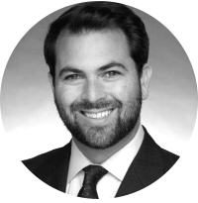
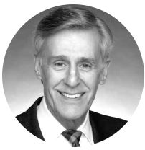
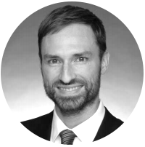
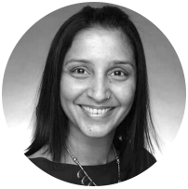
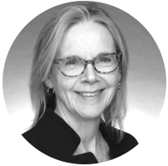
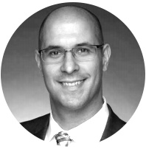
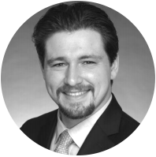
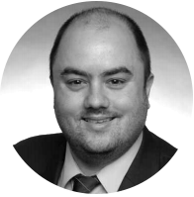
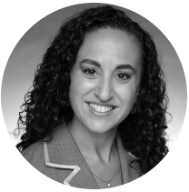
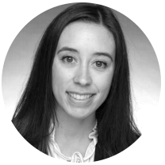
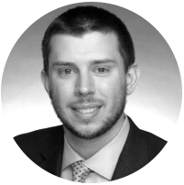
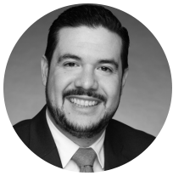
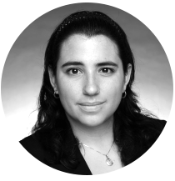
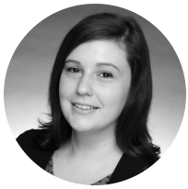
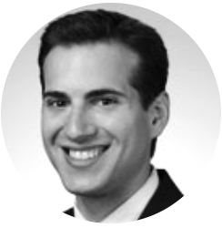
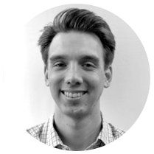
The Team That Makes a Difference
Seth Ginsberg Co-Founder & President
Louis Tharp
Executive Director
Ben Nowell, PhD, Director, Patient-Centered Research
Shilpa Venkatachalam, PhD, Associate Director, Patient-Centered Research
Laurie Ferguson, PhD, Vice President of Education
David Curtis Director, Technology and Data Services
Corey Greenblatt, MPH, Manager, Policy and Advocacy
Joseph Coe, MPA, Director, Education and Digital Strategy
Lauren Gelman, MS, Director, Editorial Services
Kelly Gavigan, MPH, Data Scientist
Ryan Johnson Administrative Coordinator
Daniel Hernandez, MD, Medical Advocacy Liaison
Danielle Ali Manager, Information Technology
Jessica Boles, MSW, LSW, Patient Advocate, Community Outreach Manager
Steven Newmark, JD, MPA,
Director, Policy
Regis Wagner, MSW, Patient Advocate, Community Outreach Manager

Slide 6





Partner on academic research projects, coauthor abstracts and studies, and present
at medical conferences
Consult on new educational products and tools for patients
Present cutting-edge science and clinical thinking to patients via webinars
Review content for medical accuracy
Represent GHLF in media to help raise the profile of arthritis and chronic illness
Medical Expertise Fuels Everything We Do
We work with leading clinicians, researchers, and thought leaders in rheumatology and other specialties to:

Slide 7



Meet Our Medical Experts*
Research
Editorial
Advisory
Jeffrey R. Curtis, MD
University of Alabama at Birmingham
Liana Fraenkel, MD
Yale University
Susan Blalock, PhD
University of North Carolina at Chapel Hill
Alexis Ogdie, MD
University of Pennsylvania
Megan Clowse, MD
Duke University School of Medicine
Theodore Fields, MD
Hospital for Special Surgery
Madelaine Feldman, MD
Tulane University
David G. Borenstein, MD
George Washington University Medical Center
Jonathan Kay, MD
UMass Memorial Medical Center
Joseph Merola, MD
Harvard Medical School
Vinicius Domingues, MD
Florida State University College of Medicine
Susan Goodman, MD
Hospital for Special Surgery
Grace Wright, MD
AWIR
Carlo Caballero Uribe, MD
Columbia, PANLAR Past President
Irwin Lim, MD
BJC Health, Sydney, Australia
*We’re fortunate to work with dozens of leading medical experts around the world.

Slide 8

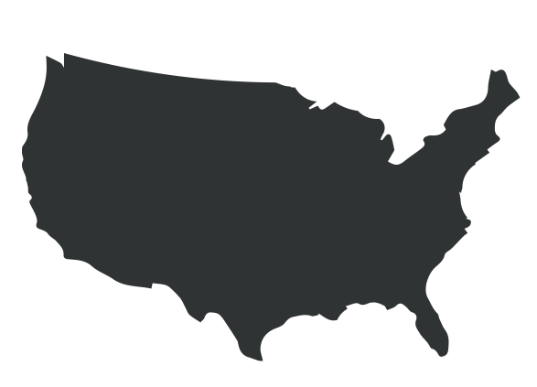


Defining Patient-Centered
Patient perspectives drive how we think. Patient actions drive what we do.
Patient Governor Group
Oversee ArthritisPower research
50-State Network
Participate in advocacy opportunities for health care access and disease awareness
Patient Council
Oversee educational programming and content
Pep Talk
Patient-to-patient peer education and support for newly diagnosed patients or those facing access issues

Slide 9








How We Engage
Patient
Decipher
Understand
Navigate
Communicate
Track
Access
Empower
Uplift
Symptom Mapping & Diagnosis Accelerator
Disease Management
Treatment Landscape
Shared Decision Making
Patient-Reported Outcomes & Research Registry
Support & Solutions for Health Care Barriers
Raise the Voice of Patients with Policymakers & Regulators
Patient-to-Patient Support & Advice
Patient Guidelines
Specialty Pharmacy Info
Diagnosis
Tear-Sheets
Patient Assistance
Programs/Directory
#Arthritis365
#CreakyChats
Open Enrollment & Insurance Guides
Pep Talk Peer Support Program

Slide 10


Balanced scorecard slide 4
New Content Strategy
News
Latest research in rheumatology
Attend/cover medical conferences
Support
Patient profiles
Patient tips and advice
Education
SEO-optimized content for the patient journey
Trusted, patient-centered information
Platform
Develop content to reach patients where they are
Social, email, search, syndication

Slide 11

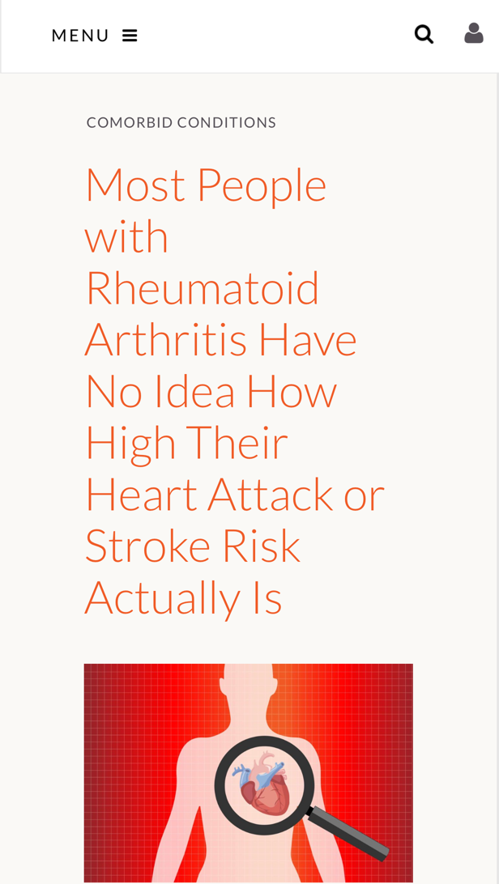
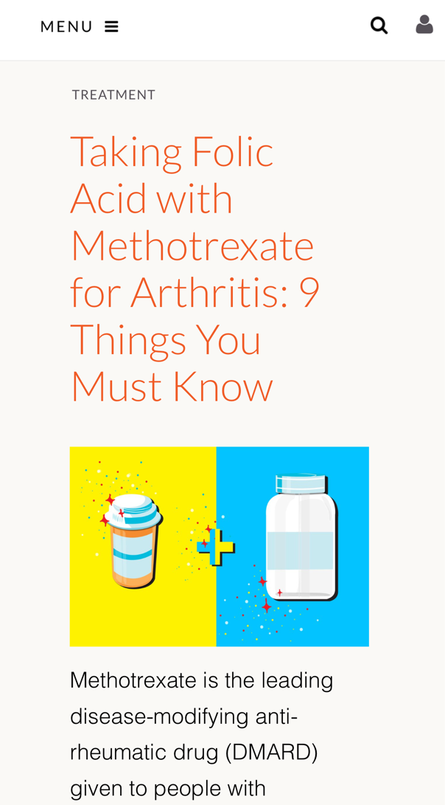
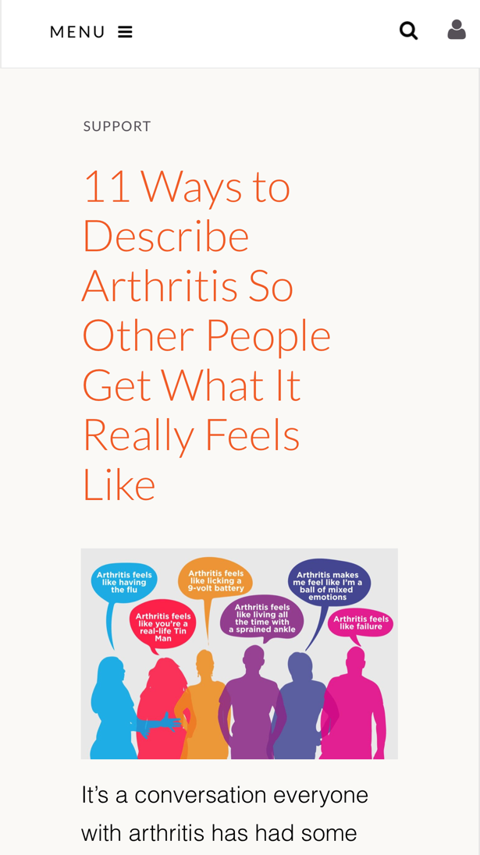

New Content Strategy
News
Education
Support

Slide 12

10x
8x
It’s Working
We’re Growing!
5x
Over the past year, we’ve seen a dramatic and sustained traffic increase
SEO
Social
Email

Slide 13
Nurturing Collaborative Advocacy
2018 Medical Conference Participation:
EULAR/PARE (Brussels ’18)
PANLAR (Argentina ’18)
APLAR (Taiwan ’18)
ACR (Chicago ’18)
ARA (Melbourne ‘18)
CSRO
CCR
RWCS
AWIR
RNS
NORM
Mayo Clinic Rheumatology
California Rheumatology
Florida Rheumatology
New York Rheumatology
Arkansas Rheumatology
Georgia Rheumatology

Slide 14
Global Expansion
Entering our 20th year, GHLF continues to attend medical conferences, harness patient communities, and deploy resources and efforts around the world:
Amsterdam
Madrid
Puerto Rico
Kaohsiung,
Taiwan
Curacao
Panama City
Quito, Ecuador
Sydney,
Australia
Buenos Aires
Wellington,
New Zealand

Slide 15

Hispanic Outreach
1. Launch CreakyJoints Español website
2. Translate Patient Guidelines for Spanish-speaking communities in the United States, including Puerto Rico, and Latin America (the Caribbean and South America)
3. Partner with Hispanic organizations and key opinion leaders
4. Leadership role with PANLAR (Pan-American League of Rheumatology) Patient Education and Advocacy
Harnessing two decades’ worth of education dissemination and community building expertise, GHLF is focusing on increasing our presence in the Hispanic community

Slide 16



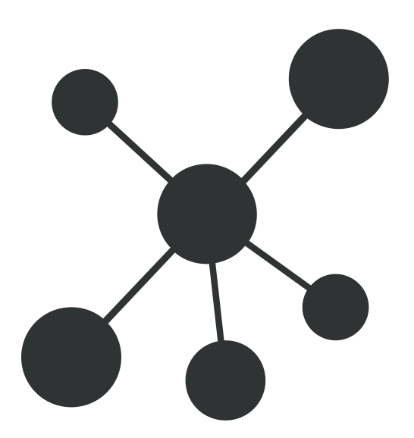
ArthritisPower
Our Patient-Powered Research Registry
Launched in 2015, ArthritisPower studies and disseminates issues that matter to patients
Patient-powered and overseen by a Patient Governor Group
Novel data collection techniques (active and passive data collection)
Enhanced individual health tracking and
user interface
Syncing with external data capabilities (clinical data research networks, EHRs, etc.)
Total Consented: 18,213
Total Number of PRO (Patient-Reported Outcomes) Assessments: 190,338

Slide 17













ArthritisPower Academic Partners
Research Activities with
20+ Institutions
Innovative patient-centered researchers using new technology
Public/private partnerships: NIH, PCORI, industry
Efficient patient-centered partners
Joining patient engagement, communication and academic researchers

Slide 18
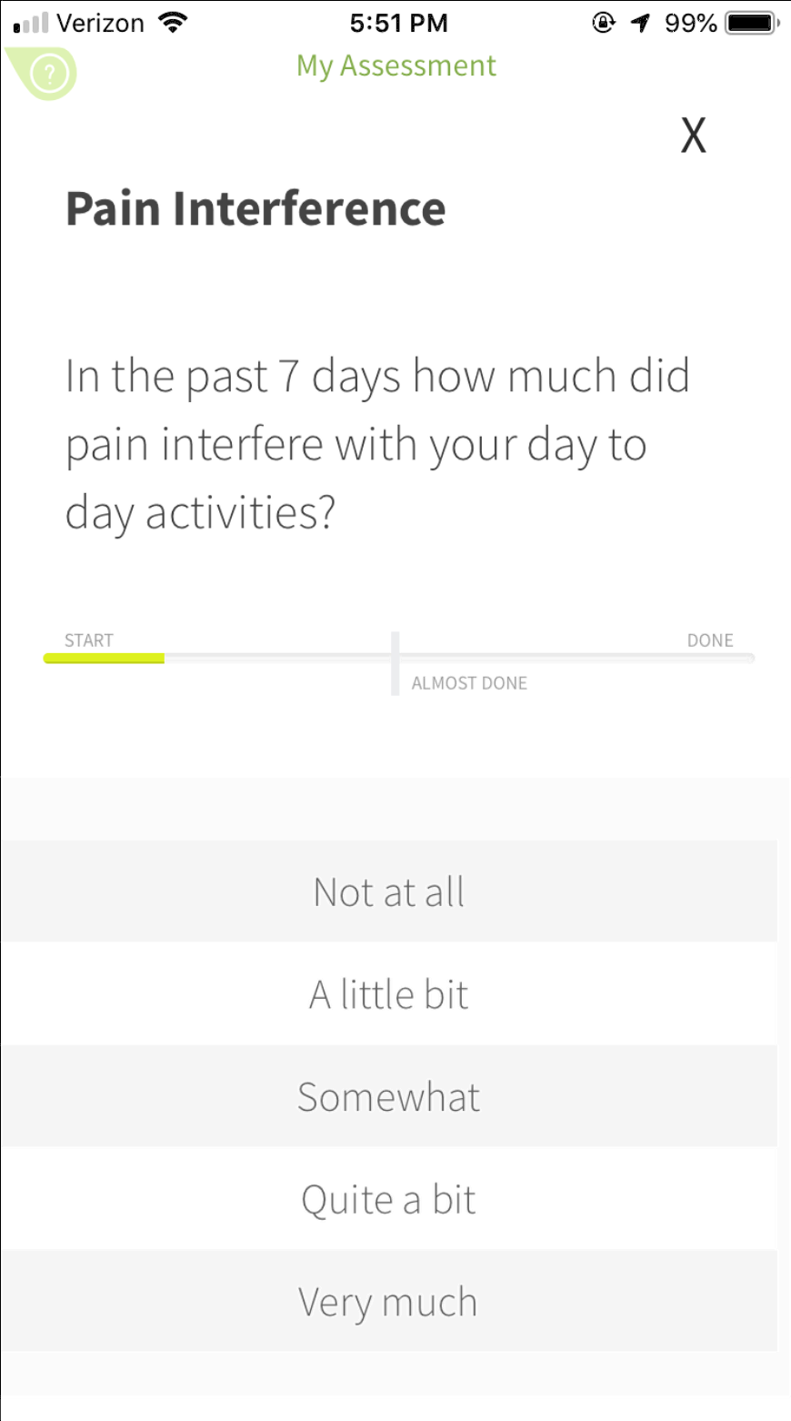
ArthritisPower: Unique App Features
Tracking:
Track your health with
customized assessments
Analytics:
View results over time / see how symptoms are changing / identify causes of symptom changes
Share:
Share results with family / caregivers / healthcare professionals
Medications:
Enter / keep track of treatments
Research Opportunities: Participate in paid / unpaid surveys and studies
Education:
Access education resources about your condition

Slide 19
PainSpot
Diagnosis Accelerator
Millions of people search the internet every day for answers about what’s causing their pain.
PainSpot by CreakyJoints can help get them diagnosed faster.
Website redesign v 2.0 in 2019
Increase engagement and enhance user experience enhancements
Algorithm update and refinement
Optimize SEO
Build post-assessment patient journey components
638,212
total diagnoses generated
How PainSpot works
Select the painful area by clicking on it
Answer a few simple questions about your pain
Get instant answers about what your diagnosis could be

Slide 20



Policy and Advocacy
Giving Patients the Platform to Make a Difference
Our grassroots advocacy arm has 1,450+ patient advocates across all 50 states and Puerto Rico
Educate
Teach patients and caregivers about access barriers and how to overcome them
Empower
Connect patients with legislators, regulators, media, and other groups to share their personal experiences
Engage
Motivate people to evolve their identity from chronic disease patient to effective advocate

Slide 21






Balanced scorecard slide 4
2019 Policy Priorities
Co-Pay Accumulators and Step Therapy
Educate about the importance of state law protections for patients
across the country
Target states: Kansas, Massachusetts, California, Oregon, Wisconsin, Maine, Virginia
Non-Medical Switching
Support mid-year and year-over-year continuity-of-care protections
Target states: Indiana, New York, Texas, Iowa, Connecticut, New Jersey, Michigan
Medication Synchronization
Educate about legislation that enables patients to have easier access to their medications
Target states: New York, Massachusetts, Pennsylvania
Pharmacy Benefit Manager Licensing
Educate about legislation that ensures PBMs have a fiduciary responsibility to the beneficiaries they represent
Drug Pricing
Ensure that policies are to the benefit of patients’ out-of-pocket costs
Biosimilar Education
Educate on the safety, efficacy, and availability of biosimilars

Slide 22


Thank You
Please stay in touch
Steven Newmark
snewmark@ghlf.org
GHLF.org
Creakyjoints.org
Arthritispower.org
50statenetwork.org
twitter.com/creakyjoints
Facebook.com/creakyjoints

